Slide 1
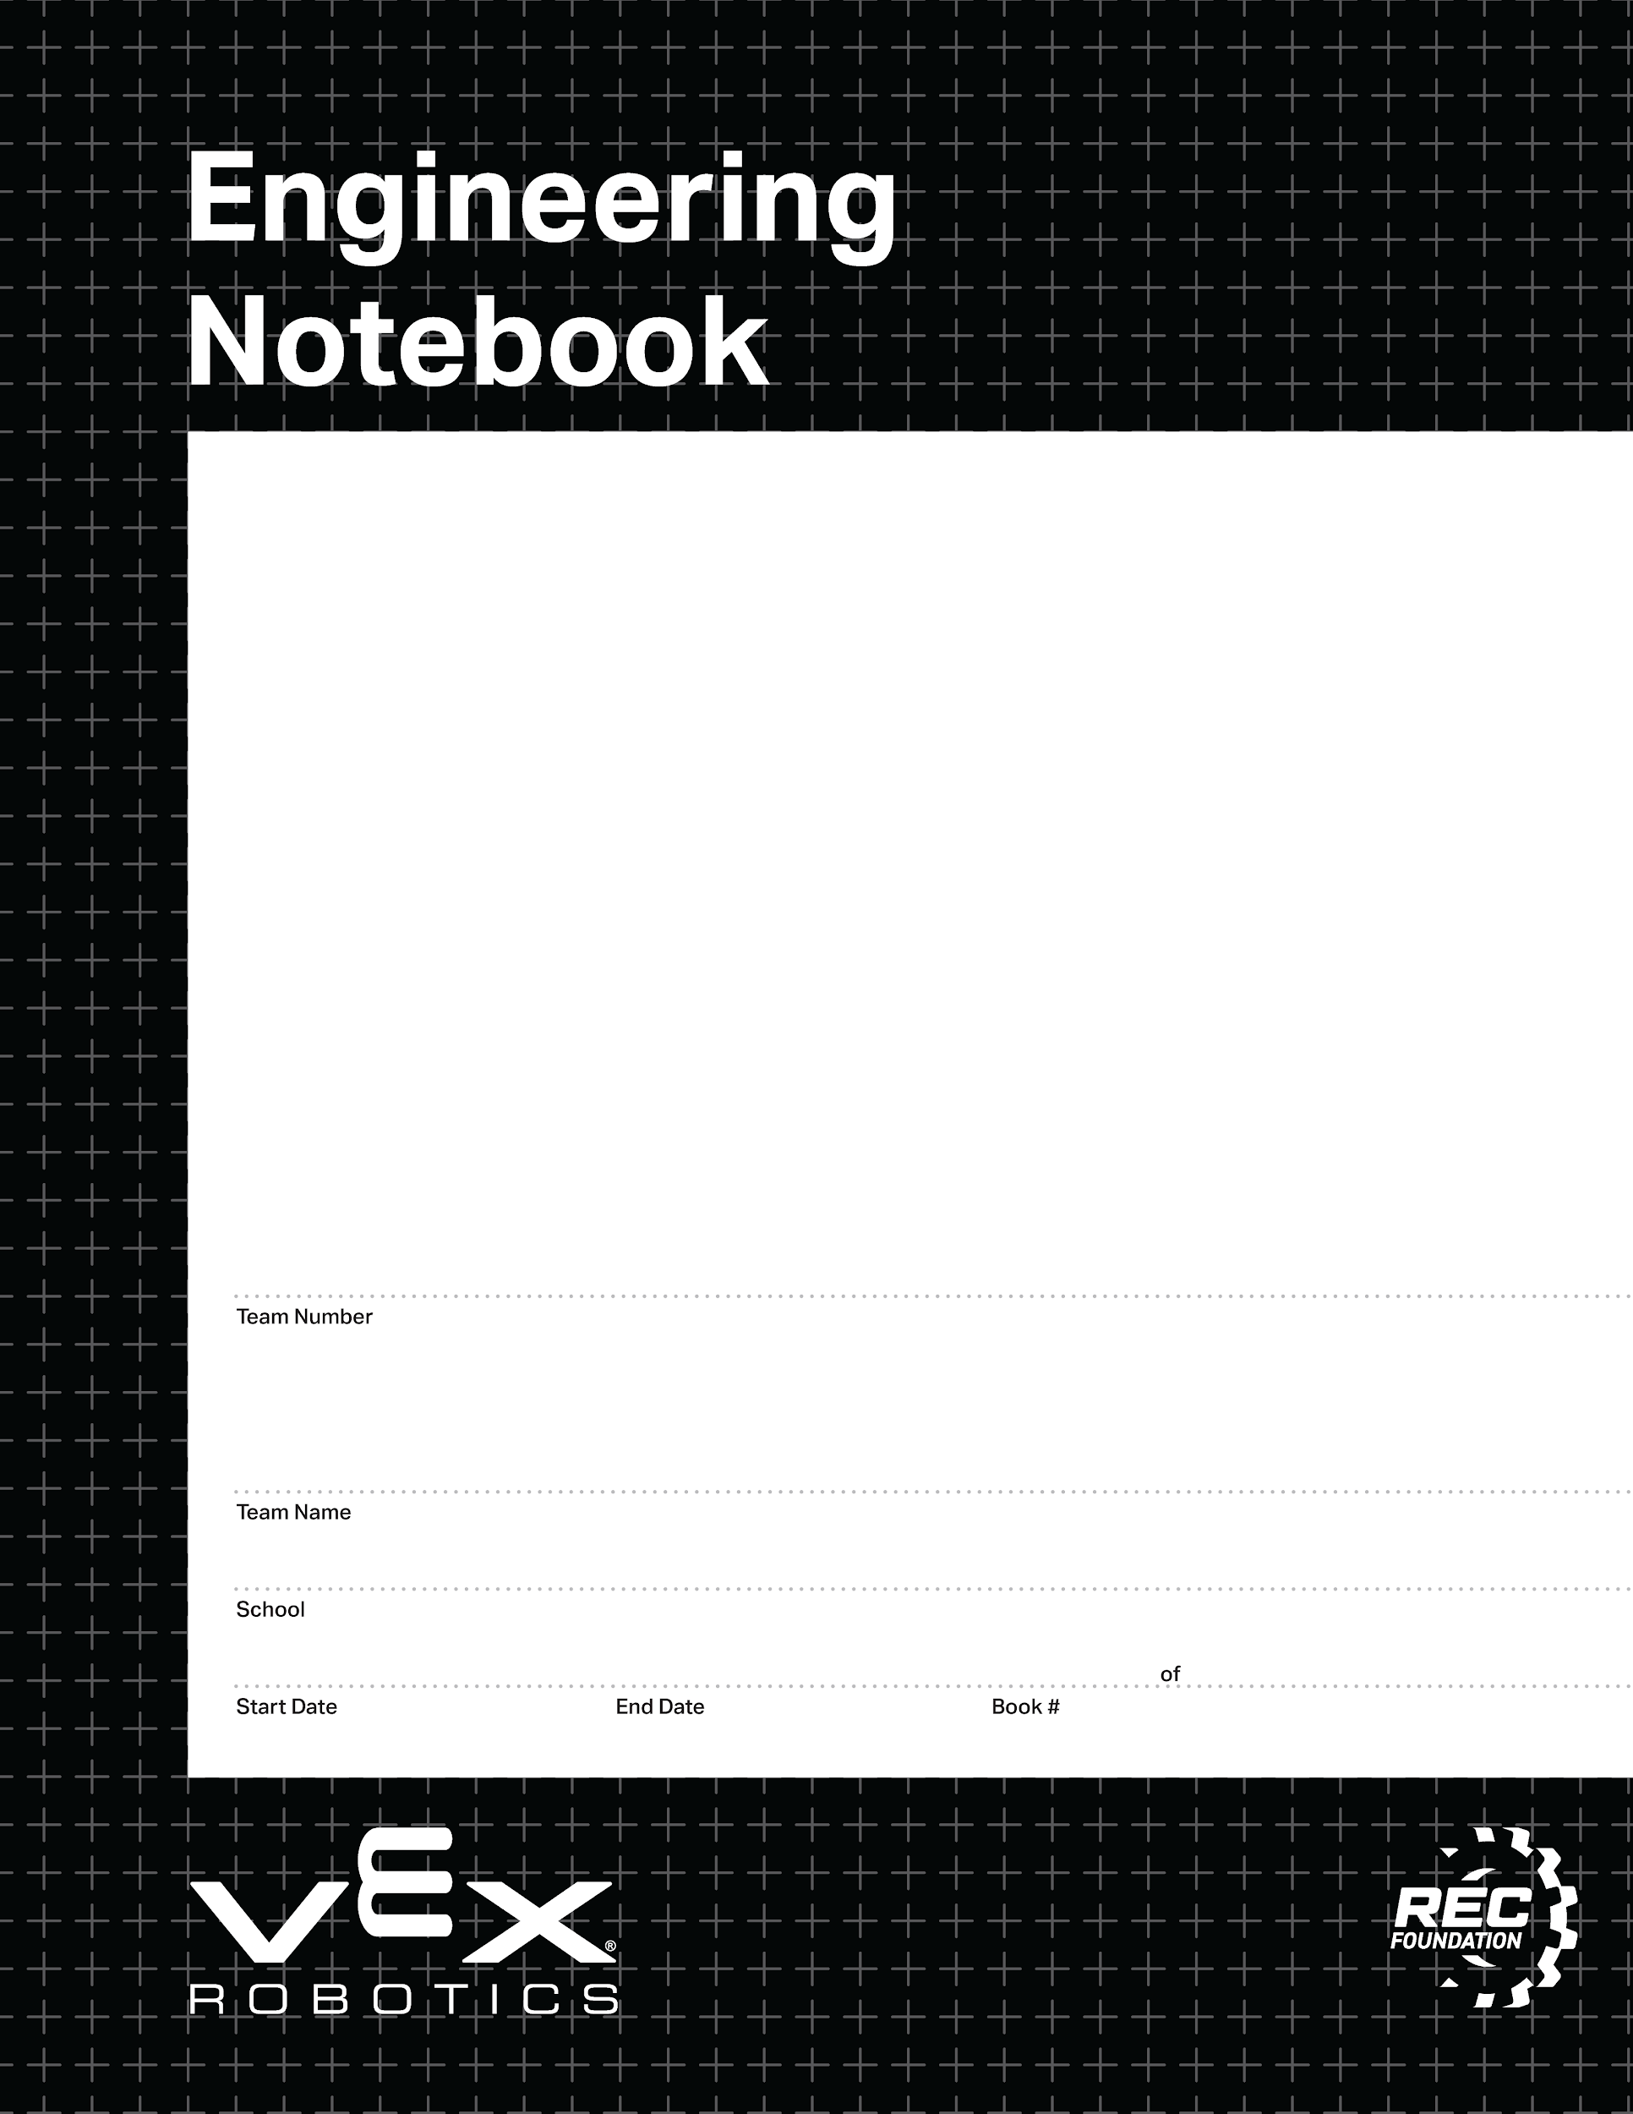

37528B
Team Strata
CEC Windsor
8/11/2025
5/15/2026
1
1
V3.0 Date 6.10.24

Slide 2
Team rules
Team Rules:
The following rules were picked by our team, to be used for the duration of this project. These rules are meant to help us resolve conflicts, work effectively, and prevent issues from happening during our project. These can be changed if agreed upon by the whole team.
All teams and teammates are trying to get to the same place, worlds, help other teams as much as possible, weather that means borrowing a battery, a screw, or an air compressor.
When there is a disagreement, we determine the result by a vote
Don’t leave the rubber bands on the robot
We do it like its prigma
Team members present:
John, Kirby, Ryder
8-11-25
2

Slide 3
1 | Team Rules | 8/1/2025
2 | Section A: Blank Documents | 8/1/2025
3 | Blank Sprint Plan | 8/1/2025
4 | Blank Scrum Meeting worksheet | 8/1/2025
5 | Blank Sprint Retrospective worksheet | 8/1/2025
6 | Blank Sprint Review worksheet | 8/1/2025
7 | Blank Research worksheet | 8/1/2025
8 | EXAMPLE research worksheet. | 8/1/2025
9 | EXAMPLE design worksheet | 8/1/2025
10 | Blank Design worksheet (1/2 scale) | 8/1/2025
11 | Blank Design worksheet (full scale) | 8/1/2025
12 | Blank Design worksheet (1/2 scale) | 8/1/2025
13 | Blank Design worksheet (1/3 scale) | 8/1/2025
15 | Blank Brain diagram worksheet | 8/1/2025
16 | Blank Controller setup worksheet | 8/1/2025
17 | Gear Ratio worksheet | 8/1/2025
18 | Section B: Filled in worksheets | 8/1/2025
27 | Notes Page 1 | 8/12/2025
28 | Sprint Plan 1 | 8/13/2025
29 | Drivetrain Research 1 | 8/13/2025
30 - 35 | Drivetrain Design 1 - 4 | 8/13/2025
36 | Scrum meetings 8/11/25 | 8/14/2025
37 | Scrum meetings 8/18/25 | 8/18/2025
38 | Block movement design 2 | 8/18/2025
39 | Block movement design 3 | 8/18/2025
40 | Wiring diagram | 8/27/2025
41 | Controller Layout Diagram | 8/27/2025
42 | Scrum meetings 8/25/25 | 8/27/2025
43 | Testing worksheet 8/25/25 | 8/27/2025
44 | Sprint 1 review | 8-9-2025
45 | Sprint 1 retrospective | 8-9-2025
46 | Sprint 2 plan | 8-29-2025
47-48 | Output design and research 1 | 9/3/2025
49 | Scrum Meetings 9/01/25 | 9/1/25
50 | Autonomous 1 | 9/3/25
51 | Autonomous 2 | 9/4/25
52 | Scrum meetings 9/8/25 | 9/8/25
53 | Scrum meetings 9/15/25 | 9/15/25
54 | Scrum meetings 9/22/25 | 9/22/25

Slide 4
55 | Sprint review 2 | 9/26/25
56 | Sprint retrospective 2 | 9/26/25
57-58 | Sprint plan 3 | 9/26/25
59 | Block loader remover research | 9/29/25
60 | Block loader remover design | 9/29/25
61 | Scrum meetings 9/29/25 | 9/29/25
62 | Scrum meetings 10/6/25 | 10/6/25
63 | Scrum meetings 10/20/25 | 10/20/25
64 | Sprint 3 retrospective | 10/21/25
65 | Scrum meetings 10/27/25 | 10/27/25
66 | Robot images | 10/31/25
67 | Sprint Retrospective 3 | 11/3/25
68 | Sprint Review 3 | 11/3/25
69 | Sprint Plan 4 | 11/3/25
70 | Scrum meetings 11/3/25 | 11/3/25
71 | Intake arm design | 11/3/25
72 | Descorer concept design | 11/6/25
73 | Scrum meetings 11/10/25 | 11/10/25
74 | Scrum meetings 11/17/25 | 11/17/25
75 | Scrum meetings 12/1/25 | 12/1/25
76 | Sprint Review | 12/4/25
77 | Sprint Retrospective | 12/5/25
78 | Sprint Plan | 12/4/25
79 | Scrum meetings 12/8/25 | 12/8/25
80 | Scrum meeting 12/15/25 | 12/15/25
81 | Scrum meeting 1/5/2 | 1/5/26

Slide 6
Section A
This section contains the blank documents for your use.
Make sure to duplicate these (or copy/paste) BEFORE you use/move them.

Slide 7
Sprint Plan (Sprint backlog and burndown)
Sprint #:
Team:
Team Members Present:
Product Backlog (at the start of this sprint, what is your product backlog):
Sprint Goal (write in full sentences what concise goal you have for the sprint):
Sprint Backlog / Burndown (Break product backlog items into sprint backlog items)
Remember to INDENT sprint backlog items:
Task Date and name of who worked on:
Page:

Slide 8
Scrum meeting. Week of: MM/DD/YYYY
SCRUM Meetings - Week of 00/00/2025
Monday: What has each team member done since the last meeting? What will each team member do today? What problems are holding the team back?
Tuesday: What has each team member done since the last meeting? What will each team member do today? What problems are holding the team back?
Wednesday: What has each team member done since the last meeting? What will each team member do today? What problems are holding the team back?
Thursday: What has each team member done since the last meeting? What will each team member do today? What problems are holding the team back?
Friday: What has each team member done since the last meeting? What will each team member do today? What problems are holding the team back?

Slide 9
Sprint Retrospective
Sprint #:
Team:
Team Members Present:
During the Sprint Retrospective you will talk with your team and discuss the last sprint. You will need to reflect on how well your team is working together, be respectful but honest, and everyone should be allowed to express themselves. Then, answer the following questions:
What is working for our team, that we should CONTINUE doing (use complete sentences):
2. What is not working for our team, that we should STOP doing (use complete sentences):
3. What do we want to try doing as a team, that we should START doing (use complete sentences):
For Each thing we want to stop doing, we should have a thing to start that solves the issue!
Date:
Page:

Slide 10
Sprint Review
Sprint #:
Team:
Team Members Present:
Using complete sentences, give a summary of what your team accomplished this sprint. Also, identify which product backlog items you fully completed:
2. Using complete sentences, tell me what your sprint goal was, did you meet that goal this sprint, and why you did or did not meet that goal:
3. What sprint backlog items do you need to move back to your product backlog? Put them in order of priority, highest priority should be at the top of the list.
4. Demonstrate the product that you produced this sprint.
Page:

Slide 11
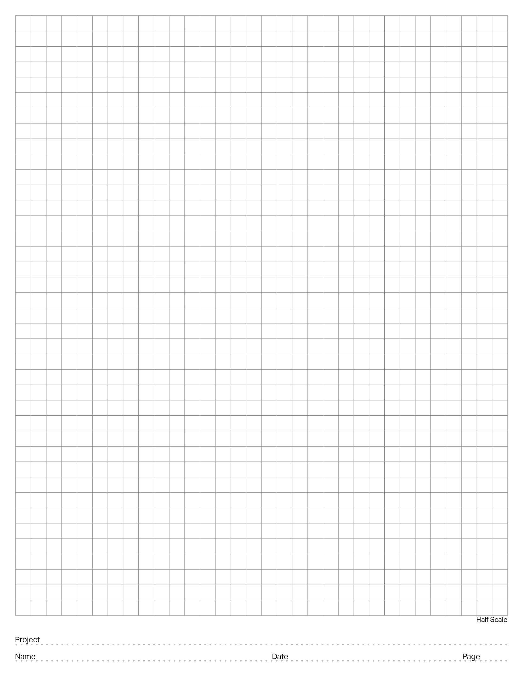
Notes Page.
Notes Page:
[Insert Notes Here]
Ryder Sandstrum
8-12-25

Slide 12
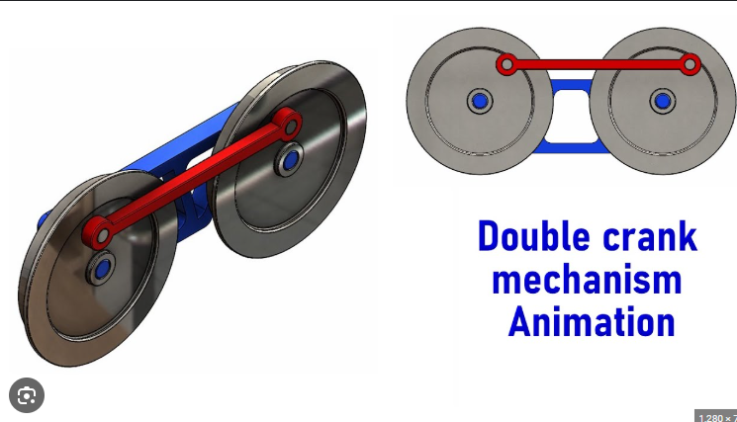
Nothing but Net
EXAMPLE - Research Page:
Identify the problem:
Clearly state an individual problem that you need to try to solve, or task that you are trying to make your robot accomplish. (i.e. do you need to lift something, grab something, push something, turn better, etc.)
I need to make a mechanism that moves a flat surface laterally, this will lift the ball up and back to my launching mechanism.
2. Find real-world examples:
Paste in pictures, video links, or screenshots of real-world examples that look like they could do the thing you are trying to do.
3. Brainstorm:
How could this example be scaled down or changed to solve your problem? What could you do to make it work?
If I use gears the same way that this train wheel double-crank mechanism works, I can easily move the ball how I need to.
Mr. Lyon
4/15/2025
5

Slide 13
Research Page:
Identify the problem:
Clearly state an individual problem that you need to try to solve, or task that you are trying to make your robot accomplish. (i.e. do you need to lift something, grab something, push something, turn better, etc.)
2. Find real-world examples:
Paste in pictures, video links, or screenshots of real-world examples that look like they could do the thing you are trying to do.
3. Brainstorm:
How could this example be scaled down or changed to solve your problem? What could you do to make it work?

Slide 14
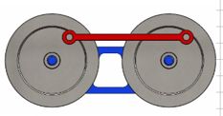

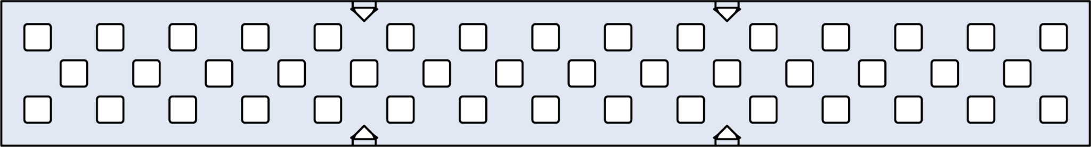


Nothing but Net Bot
EXAMPLE - Plan and Design Page:
-Drag, drop, rotate, and position vex V5 parts from the PowerPoint “V5 Parts Library” onto this slide to plan out how your robot or robot mechanism will fit together.
-Use the ‘crop’ tool to cut pieces down, DO NOT just drag them bigger/smaller. This will mess up the scale of your design, and the parts will not fit together on your robot that way.
-This design should come AFTER a filled-out research page.
-This design isn’t a copy of what we already built, it’s a plan for what we want to build.
Double crank mechanism to lift balls to shooting area~!
-use aluminum so this is light and strong
-Cut the short edges off so this is thinner but retains strength
-standoffs to span space for rubber bands to lift ball
Slip inserts so the gears spin smoothly
Mr. Lyon
4/16/2025
6

Slide 15
Plan and Design Page:
-Drag, drop, rotate, and position vex V5 parts from the PowerPoint “V5 Parts Library” onto this slide to plan out how your robot or robot mechanism will fit together.
-Use the ‘crop’ tool to cut pieces down, DO NOT just drag them bigger/smaller. This will mess up the scale of your design, and the parts will not fit together on your robot that way.
-This design should come AFTER a filled-out research page.
-This design isn’t a copy of what we already built, it’s a plan for what we want to build.

Slide 16
Plan and Design Page:
-Drag, drop, rotate, and position vex V5 parts from the PowerPoint “V5 Parts Library” onto this slide to plan out how your robot or robot mechanism will fit together.
-Use the ‘crop’ tool to cut pieces down, DO NOT just drag them bigger/smaller. This will mess up the scale of your design, and the parts will not fit together on your robot that way.
-This design should come AFTER a filled-out research page.
-This design isn’t a copy of what we already built, it’s a plan for what we want to build.

Slide 17
Plan and Design Page:
-Drag, drop, rotate, and position vex V5 parts from the PowerPoint “V5 Parts Library” onto this slide to plan out how your robot or robot mechanism will fit together.
-Use the ‘crop’ tool to cut pieces down, DO NOT just drag them bigger/smaller. This will mess up the scale of your design, and the parts will not fit together on your robot that way.
-This design should come AFTER a filled-out research page.
-This design isn’t a copy of what we already built, it’s a plan for what we want to build.

Slide 18
Plan and Design Page:
-Drag, drop, rotate, and position vex V5 parts from the PowerPoint “V5 Parts Library” onto this slide to plan out how your robot or robot mechanism will fit together.
-Use the ‘crop’ tool to cut pieces down, DO NOT just drag them bigger/smaller. This will mess up the scale of your design, and the parts will not fit together on your robot that way.
-This design should come AFTER a filled-out research page.
-This design isn’t a copy of what we already built, it’s a plan for what we want to build.

Slide 19
Testing Worksheet
Mechanism: Builder:
Tester:
Use this worksheet to test the mechanism that you researched, planned, and then built.
Does the mechanism perform the function as intended?
Does the mechanism fit within the games rule requirements?
Durability testing, does the mechanism hold up to the following?
Impact - (bump from various directions)
Torsion - (twisting force, try and spin it.)
Load - (does it hold appropriate weight)
Torque - (if is motorized, can it supply enough power?)
Bending - (apply force to one side, then another)
Handling - (Does the robot still drive as expected with the mechanism installed?)
Cycle - (how many times can it do its function repeatedly)
Does the mechanism perform under game conditions?
Test Feedback:
What did you learn from your testing? Think about usable quantitative data (measurements) and qualitative data (observations and opinions). Do we need a full redesign, or can we change something small to gain the functionality that we wanted? If redesign is needed, go back to the research/brainstorm step, and do that worksheet again!
Date:
Page:

Slide 20
PORT
PORT
PORT
PORT
PORT
PORT
PORT
PORT
PORT
PORT
PORT
PORT
L
PORT
PORT
PORT
PORT
PORT
PORT
PORT
PORT
PORT
PORT
PORT
PORT
PORT
PORT
PORT
PORT

Slide 21
BUMPER
BUMPER
BUMPER
BUMPER
STICK
STICK
STICK
STICK
BUTTON
BUTTON
BUTTON
BUTTON
BUTTON
BUTTON
BUTTON
BUTTON

Slide 22
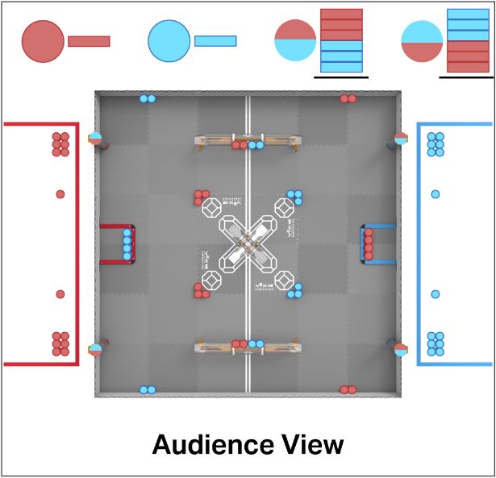
“Push Back” Starting Field with Frozen Game Objects
Autonomous Plan Template

Slide 23
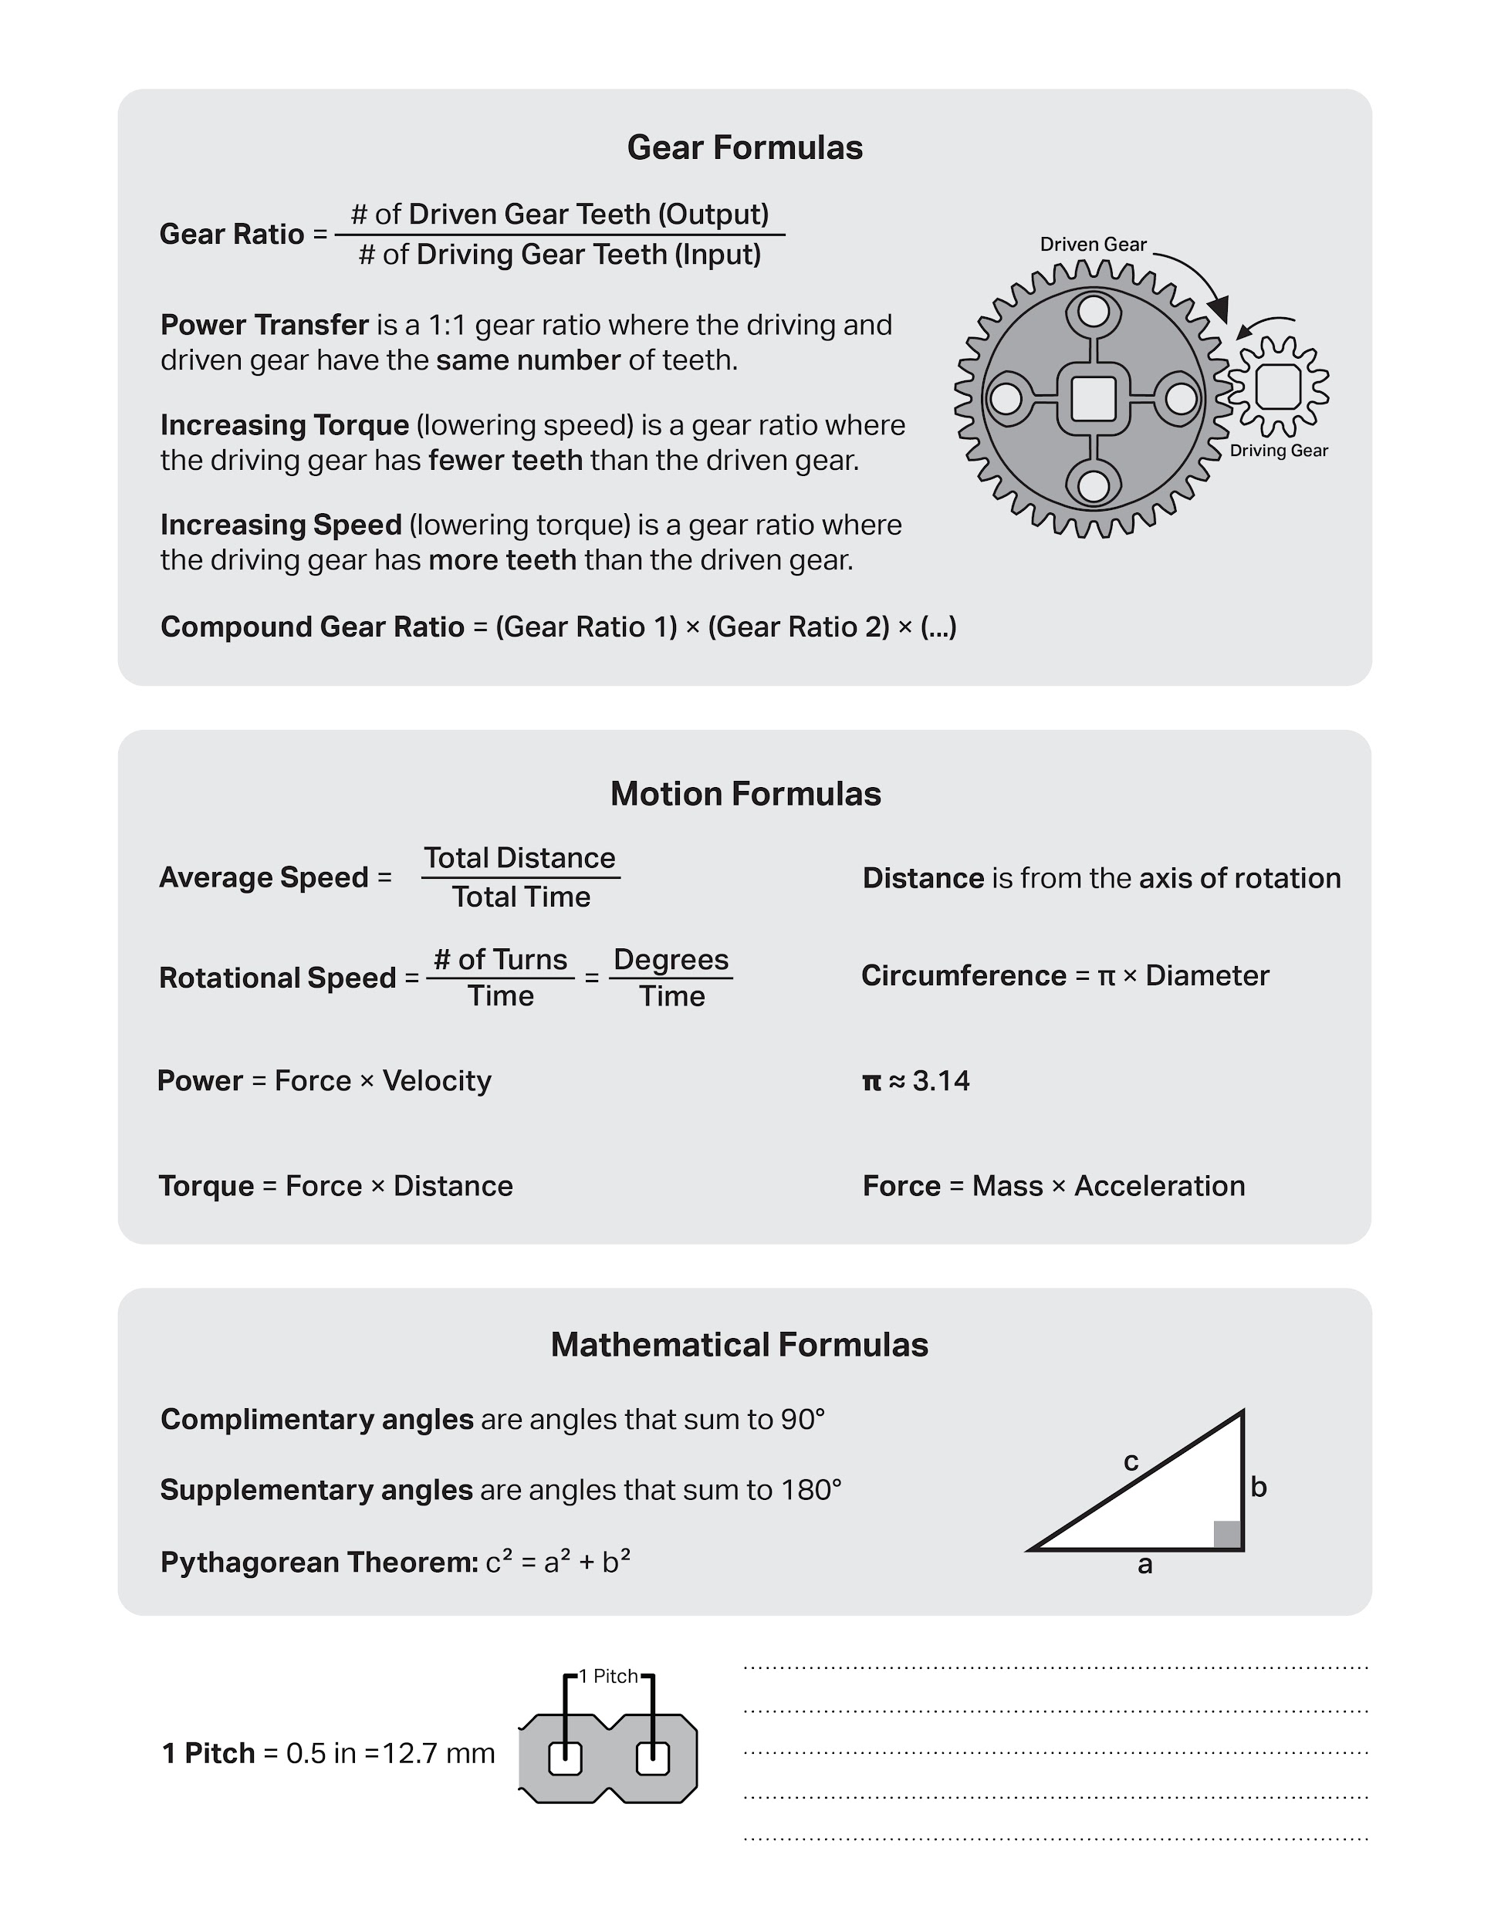

Slide 24
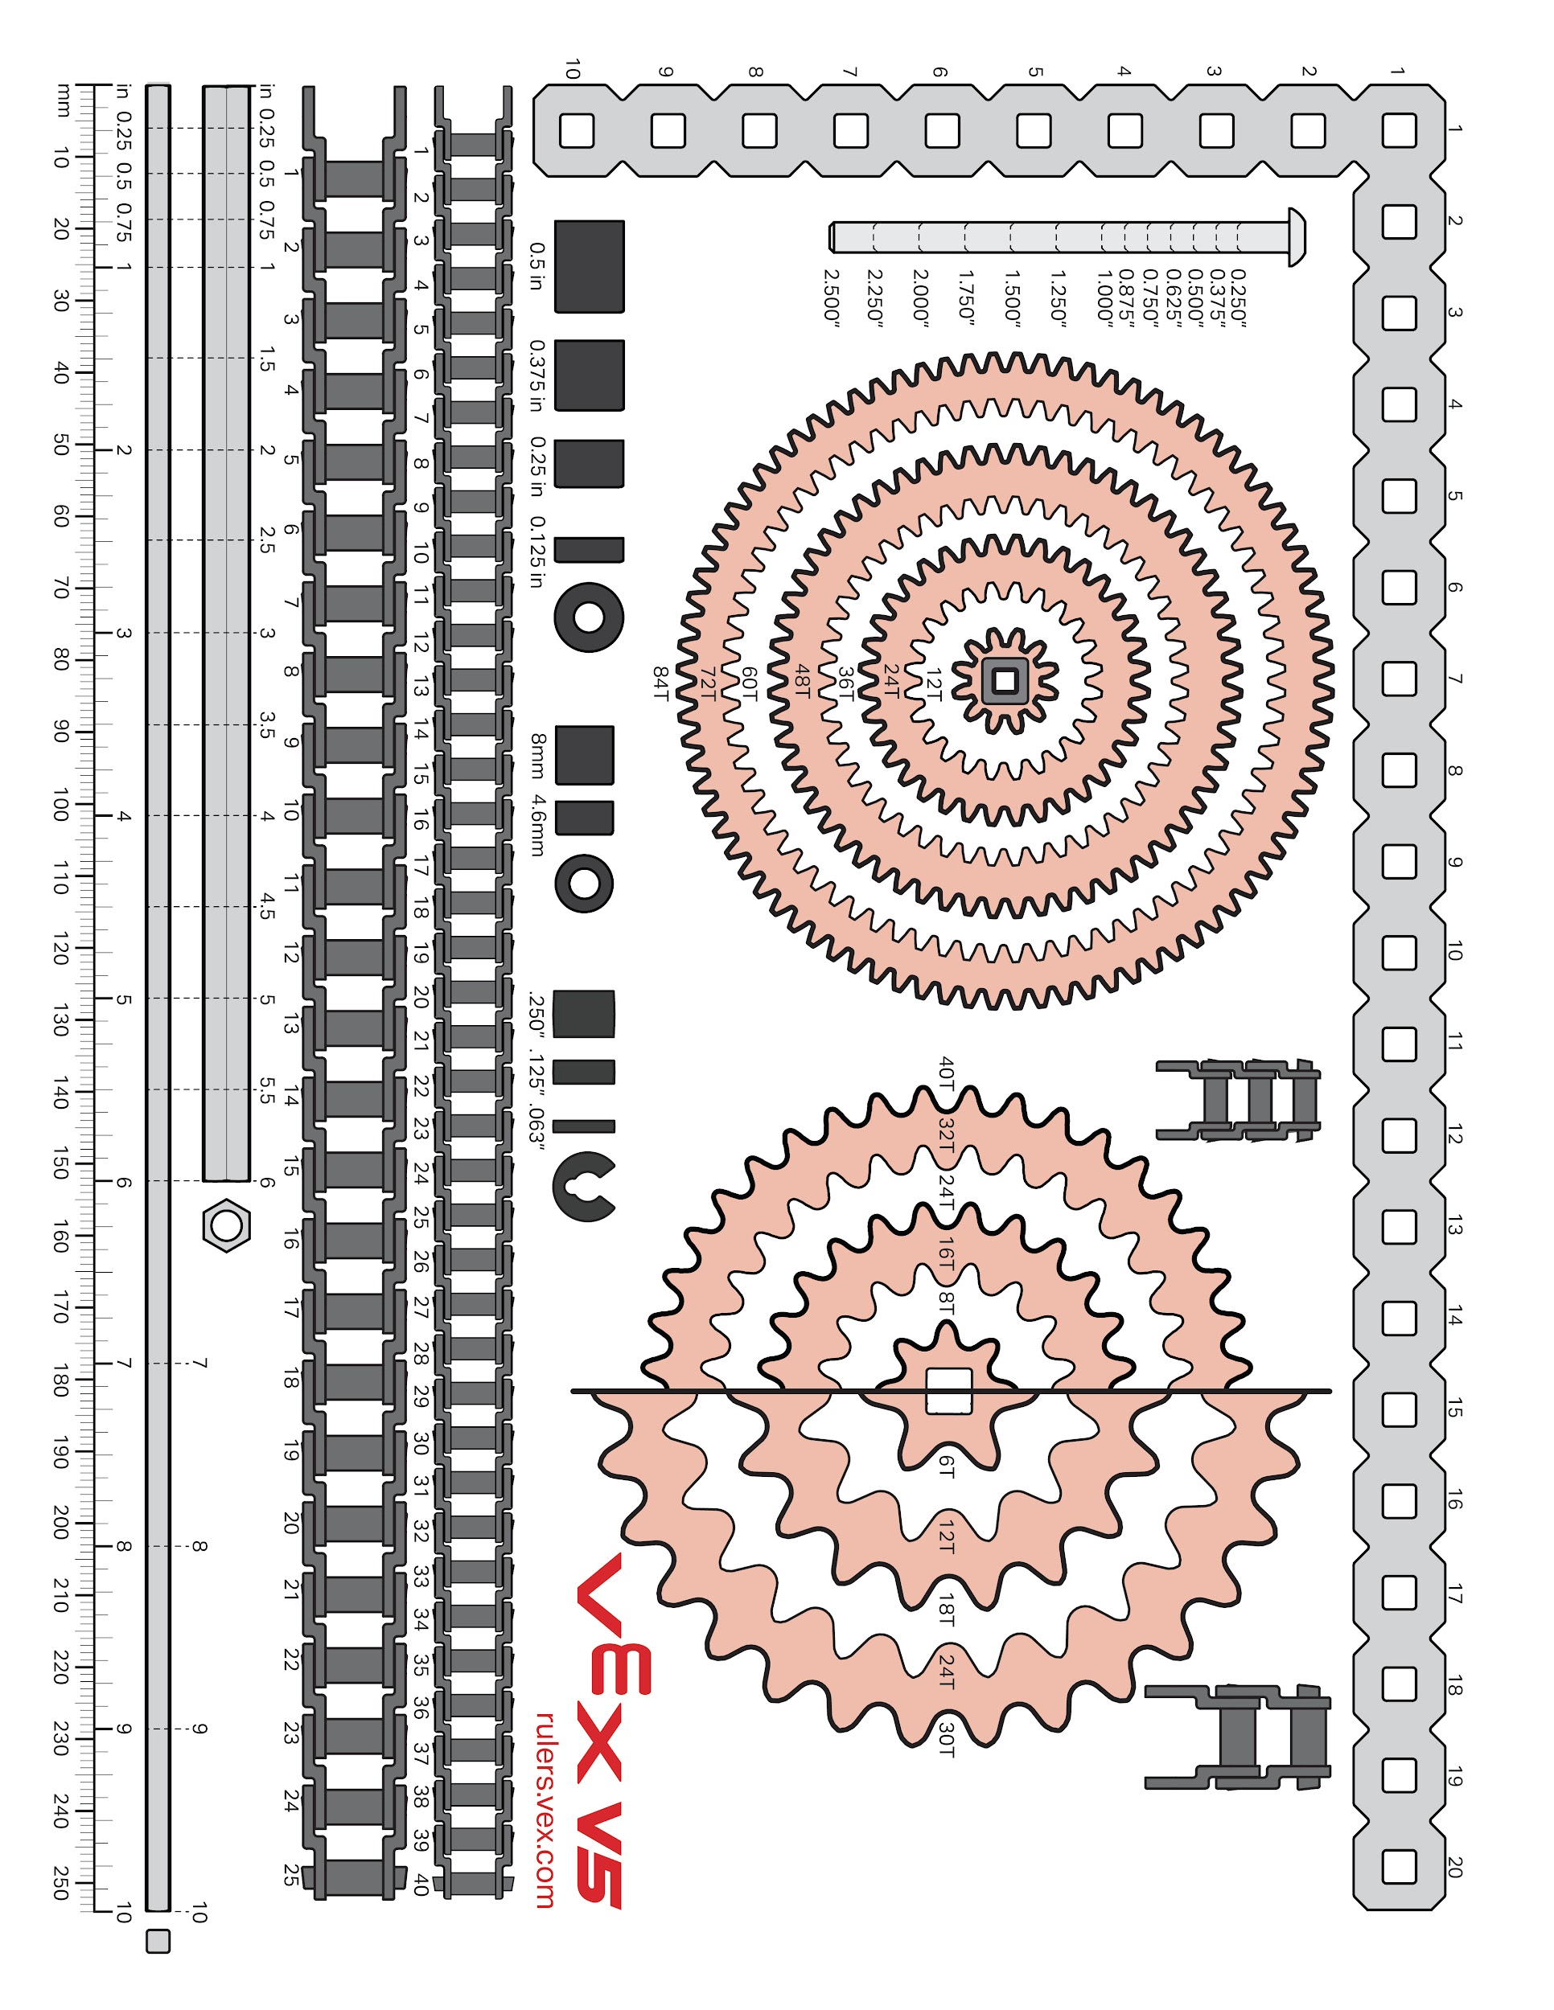

Slide 25
Competition reflection
Robot changes:
Code changes:
Driver control changes:
Additional notes:

Slide 26
Section B
This section contains the filled-in documents for your notebook.
These should be in chronological order, with older documents at the beginning, and new documents at the end.

Slide 27
Notes Page 1
Notes Page:
The Autonomous win point is very demanding.​
At least seven (7) Blocks of the Alliance’s color are Scored. ​
At least three (3) different Goals include at least one (1) Scored Block ofthe Alliance’s color. ​
At least three (3) Blocks of the Alliance’s color have been removed from Loaders adjacent to the Alliance’s Alliance Station.​
Robot must start contacting the Park Zone barrier.​
https://www.youtube.com/watch?v=hJfvXvzXRU8&msockid=b3fc626e793c11f0b15f83c6071b4ab8
https://www.youtube.com/watch?v=RzNhC3XdxLE&t=4s
This video shows that you can fit two robots in the parking space by just slamming both robots together in the parking space.
<SC5> B Both teams gain 5 points if the Autonomous ends in a tie.
<SG1> F States a robot must be touching the parking spot at the game start.
<SG11> Park Zones are protected during the endgame. During the last 20 seconds of a Match, Robots may not directly or indirectly contact the other Alliance’s Park Zone or opponent Robots that are Parked in that Zone.
<R24> B allows for go pros to be on the robot. What about a insta 360
GET MR LYON TO UPDATE THE PARTS NOTEBOOK TO PUSH BACK INSTEAD OF HIGH STAKES
Team name idea of "Byte Me"
Ryder Sandstrum
8-12-25
26

Slide 28
Sprint Plan (Sprint backlog and burndown)
Sprint #:
Team:
1
Team Members Present:
37528B
Kirby, John, and Ryder
Product Backlog (at the start of this sprint, what is your product backlog):
Design and build drivetrain and chassis
Design and build "Scoring system"
Frame
Intake
Conveyer belt
"Pink Notebook"
"Media Training"
Code
Driver Control code
Code motor groups etc
Skills
Autonomous match start.
Stress test the robot
Strategize skills and matches
Competition readiness check
Sprint Goal (write in full sentences what concise goal you have for the sprint):
Design, prototype, and test a functional drivetrain, using a series gear system to warrant balanced power delivery to the ground as well as speed.
Sprint Backlog / Burndown (Break product backlog items into sprint backlog items)
Remember to INDENT sprint backlog items:
Task Date and name of who worked on:
Backlog Item:
Desiign and build drive train.
1. Research drivetrain idea
2. Design drivetrain
3. Prototype drivetrain on one side
4. Code Controller motor Group.
5. Test One side and record test.
6. Build both sides
7. Test both sides and record test
Date Completed:
1. 8-13-25
2. 8-13-25
3. 8- 14-25
4. 8-18-25
5.
6. 8-22-25
7. 8-25-25
27
Page:

Slide 29
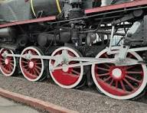
Drivetrain Research 1
Research Page:
Identify the problem:
Clearly state an individual problem that you need to try to solve, or task that you are trying to make your robot accomplish. (i.e. do you need to lift something, grab something, push something, turn better, etc.)
We require a AWD drivetrain which need to be fast, high torque, and strong power delivery to the ground, while also being more reliable than 37528A's High Stakes robot's drivetrain.
2. Find real-world examples:
Paste in pictures, video links, or screenshots of real-world examples that look like they could do the thing you are trying to do.
While being not the same as our plan for our drivetrain, it is similar where one or more wheels get driven by the engine of the train, and the rest have links from the powered wheels which make it so all wheels turn at the same time.
3. Brainstorm:
How could this example be scaled down or changed to solve your problem? What could you do to make it work?
We can have gears behind the wheels linking all the wheels for maximum power delivery to the ground.
Ryder Sandstrum
8-13-25
28

Slide 30
Drivetrain Design 1
Plan and Design Page:
-Drag, drop, rotate, and position vex V5 parts from the PowerPoint “V5 Parts Library” onto this slide to plan out how your robot or robot mechanism will fit together.
-Use the ‘crop’ tool to cut pieces down, DO NOT just drag them bigger/smaller. This will mess up the scale of your design, and the parts will not fit together on your robot that way.
-This design should come AFTER a filled-out research page.
-This design isn’t a copy of what we already built, it’s a plan for what we want to build.
Ryder Sandstrum
8-13-2025
29

Slide 31




Drivetrain Design 2
Plan and Design Page:
Drivetrain side
The supports keep the axles from bending
Gear chain allows all wheels to spin at the same speed
Two motors allows for more control over the robot
Three wheels allows the robot to have more traction and prevent it from getting stuck.
John Hopkins
8-13-2025
30

Slide 32


Plan and Design Page:
Basic chassis design
8/13/25

Slide 33
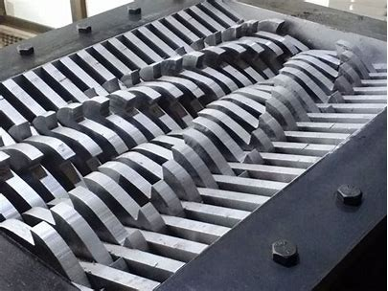
Intake Research 1
Research Page:
Identify the problem:
Clearly state an individual problem that you need to try to solve, or task that you are trying to make your robot accomplish. (i.e. do you need to lift something, grab something, push something, turn better, etc.)
We need a intake that can pick in 3 ¼ inch blocks efficiently while using minimal parts for maximum simplicity while also using 1 motor.
2. Find real-world examples:
Paste in pictures, video links, or screenshots of real-world examples that look like they could do the thing you are trying to do.
An industrial scrapping machine has two rotating shafts which pull any items into the machine while also crushing and pulling them apart.
3. Brainstorm:
How could this example be scaled down or changed to solve your problem? What could you do to make it work?
If we use a similar intake where both sides spin and pull the blocks in, (while wheels instead of the metal shafts, being farther apart because we don’t want to crush the blocks). We can have a motor on one side with a gear connecting it to the other wheel so the right side would spin clockwise, and the left would spin counter-clockwise. If we use green motors then we can have enough speed to launch them into some sort of conveyer belt, while also being resistant to blocks getting stuck..
Ryder Sandstrum
8-14-25
31

Slide 34



Intake design 1
Plan and Design Page:
Intake design 2
Untitled
Block would enter from the bottom and get push upwards. Following the direction of the arrow.
Ryder Sandstrum
8-14-2025
32

Slide 35
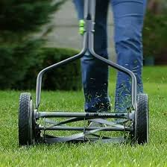
Intake Research 2
Research Page:
Identify the problem:
Clearly state an individual problem that you need to try to solve, or task that you are trying to make your robot accomplish. (i.e. do you need to lift something, grab something, push something, turn better, etc.)
We need a intake that can pick in 3 ¼ inch blocks efficiently while using minimal parts for maximum simplicity while also using 1 motor.
2. Find real-world examples:
Paste in pictures, video links, or screenshots of real-world examples that look like they could do the thing you are trying to do.
A real lawn mower spins blades which are connected to the wheels via gears.
3. Brainstorm:
How could this example be scaled down or changed to solve your problem? What could you do to make it work?
While the reel lawn mower is used for a different purpose the mechanism would be similar and pull the blocks through, we would use rubber bands with their elasticity to grip the blocks
Ryder Sandstrum
8-15-25
33

Slide 36




Intake ideas 2
Plan and Design Page:
Intake and block movement design 1
A
B
C
These images are of an alternative option for a intake where rubber bands would be stretched between the goals.
John Hopkins
8-14-2025
34

Slide 37
Scrum meeting.
SCRUM Meetings
Week of 8/11/2025
Monday: What has each team member done since the last meeting? What will each team member do today? What problems are holding the team back?
Tuesday: What has each team member done since the last meeting? What will each team member do today? What problems are holding the team back?
Wednesday: What has each team member done since the last meeting? What will each team member do today? What problems are holding the team back?
Thursday: What has each team member done since the last meeting? Research and design on drive train and intake What will each team member do today? All will continue research and start prototyping What problems are holding the team back? N/A
Friday: What has each team member done since the last meeting? More research on drive train and intakes What will each team member do today? Assemble drive train What problems are holding the team back? N/A
Ryder Kirby John
8-14-25
35

Slide 38
Scrum meeting. Week of: MM/DD/YYYY
SCRUM Meetings
Week of 8/18/2025
Monday: What has each team member done since the last meeting? Made more progress on the drivetrain. What will each team member do today? Rebuilding the drivetrain to fix a problem. What problems are holding the team back? The motors were in the wrong place, so that’s why we are rebuilding the drivetrain.
Tuesday: What has each team member done since the last meeting? Drivetrain is partially rebuilt What will each team member do today? Attempting to attach the wheels to the drivetrain and begin working on the intake. What problems are holding the team back? None so far
Wednesday: What has each team member done since the last meeting? Intake 1 completed, half of drivetrain completed. What will each team member do today? Finish building drivetrain, code controller. What problems are holding the team back? None
Thursday: What has each team member done since the last meeting? Worked on drivetrain and started working on code. What will each team member do today? Working on the drivetrain What problems are holding the team back? None
Friday: What has each team member done since the last meeting? Both drivetrain halves have been completed, brain code worked on. What will each team member do today? Combining the two halves of the drivetrain What problems are holding the team back? Kirby cannot continue bug testing drive code because the drivetrain is not complete yet.
36

Slide 39

Plan and Design Page:
Block movement design 2
8-18-25

Slide 40




Block movement 3 Unused
Plan and Design Page:
Block movement design 3
8-18-25

Slide 41
Wiring diagram
Intake Motor (Right-hand)
DT Motor L 1
Conveyor
Motor
DT Motor L 2
Output Motor
DT Motor R 1
UNOCCUPIED
DT Motor R 2
UNOCCUPIED
Intake Motor (Left-hand)
UNOCCUPIED
UNOCCUPIED
UNOCCUPIED
UNOCCUPIED
UNOCCUPIED
UNOCCUPIED
UNOCCUPIED
UNOCCUPIED
Inertia Sensor
UNOCCUPIED
RADIO
UNOCCUPIED
UNOCCUPIED
Sonar Sensor
Sonar Sensor
UNOCCUPIED
UNOCCUPIED
UNOCCUPIED
Pneumatics Valve
Kirby Larson
8-20-25
40

Slide 42
Control layout diagram
INTAKE IN
OUTPUT
UNDER
INTAKE OUT
OUTPUT
UPPER
DRIVE (F B)
UNUSED
DRIVE (L R)
DRIVE (L R)
Block lever
OUT
INTAKE HALF-SPEED MODE (HOLD)
UNUSED
UNUSED
UNUSED
DRIVETRAIN HALF-SPEED MODE (HOLD)
Block lever
IN
UNUSED
Kirby Larson
8-20-25
41

Slide 43
Scrum meeting. Week of: MM/DD/YYYY
SCRUM Meetings
Week of 08/25/2025
Monday: What has each team member done since the last meeting? Progress on drivetrain code. Drivetrain completed. What will each team member do today? Coding and testing drivetrain. John is adding more stabilization to the drivetrain. What problems are holding the team back? None
Tuesday: What has each team member done since the last meeting? Tested the robot and reenforced the drivetrain. Also finished the drivetrain code. What will each team member do today? Attaching the intake What problems are holding the team back? None
Wednesday: What has each team member done since the last meeting? Working on attaching intake What will each team member do today? Continue work on intake What problems are holding the team back? None
Thursday: What has each team member done since the last meeting? Attached Intake What will each team member do today? Design rest of scoring system What problems are holding the team back? None
Friday: What has each team member done since the last meeting? Attached plastic parts and adjusted controller layout. What will each team member do today? Starting new sprint and designing a conveyor belt. What problems are holding the team back? None

Slide 44
Testing Worksheet
Mechanism: Builder:
Tester:
Drivetrain
John Hawkins
Ryder Sandstrum
Use this worksheet to test the mechanism that you researched, planned, and then built.
Does the mechanism perform the function as intended?
Does the mechanism fit within the games rule requirements?
Durability testing, does the mechanism hold up to the following?
Impact - (bump from various directions)
PASS
We ran it into a wall multiple times and beat it up with a stick.
Torsion - (twisting force, try and spin it.)
PASS
It twists slightly, but not enough to affect the robot's functionality.
Load - (does it hold appropriate weight)
PASS
Torque - (if is motorized, can it supply enough power?)
PASS
Bending - (apply force to one side, then another)
PASS
Handling - (Does the robot still drive as expected with the mechanism installed?)
PASS
Cycle - (how many times can it do its function repeatedly)
PASS
We ran it into a wall multiple times
Does the mechanism perform under game conditions?
Test Feedback:
What did you learn from your testing? Think about usable quantitative data (measurements) and qualitative data (observations and opinions). Do we need a full redesign, or can we change something small to gain the functionality that we wanted? If redesign is needed, go back to the research/brainstorm step, and do that worksheet again!
8/25/25
43
Date:
Page:

Slide 45
Sprint Review
Sprint #:
Team:
1
Team Members Present:
37528B
Ryder Sandstrum
John Hopkins
Kirby Larson
Using complete sentences, give a summary of what your team accomplished this sprint. Also, identify which product backlog items you fully completed:
This sprint we built and completed (includes testing and improving) the drive train, we have also built the intake which we cannot completely test it until we have the rest of the scoring system complete.
2. Using complete sentences, tell me what your sprint goal was, did you meet that goal this sprint, and why you did or did not meet that goal:
Design, prototype, and test a functional drivetrain, using a series gear system to warrant balanced power delivery to the ground as well as speed.
We met our sprint goal by completing our drivetrain using the system we planned in the sprint goal.
3. What sprint backlog items do you need to move back to your product backlog? Put them in order of priority, highest priority should be at the top of the list.
Currently, none.
4. Demonstrate the product that you produced this sprint.
Page:
44

Slide 46
Sprint Retrospective
Sprint #:
Team:
Team Members Present:
1
Ryder Sandstrum
John Hopkins
Kirby Larson
37528B
During the Sprint Retrospective you will talk with your team and discuss the last sprint. You will need to reflect on how well your team is working together, be respectful but honest, and everyone should be allowed to express themselves. Then, answer the following questions:
What is working for our team, that we should CONTINUE doing (use complete sentences):
Designing and researching what we need to build before building, as well as extensive planning of our robot.
Also continue communicating with each other.
2. What is not working for our team, that we should STOP doing (use complete sentences):
Stop overlooking documentation by documenting everything important (more in start doing)
3. What do we want to try doing as a team, that we should START doing (use complete sentences):
For Each thing we want to stop doing, we should have a thing to start that solves the issue!
Documenting progress with pictures simply by taking them between competitions and take pictures of newly built parts and updating the notebook more often by using things that we don't normally put in the notebook and documenting every change.
8-29-25
45
Date:
Page:

Slide 47
Sprint Plan (Sprint backlog and burndown)
Sprint #:
Team:
2
Team Members Present:
37528B
Kirby, John, and Ryder
Product Backlog (at the start of this sprint, what is your product backlog):
Design and build drivetrain and chasis
Design and build "Scoring system"
Frame
Intake
Conveyer belt
"Pink Notebook"
"Media Training"
Code
Driver Control code
Code motor groups etc
Skills
Autonomous match start.
Stress test the robot
Strategize skills and matches
Competition readiness check
Sprint Goal (write in full sentences what concise goal you have for the sprint):
Research and design the rest of the scoring system, then test it, if extra time,
Sprint Backlog / Burndown (Break product backlog items into sprint backlog items)
Remember to INDENT sprint backlog items:
Backlog Item:
Build Scoring system
Research conveyer belt
Research Block Loader
Design conveyer belt
Design block loader
Build Frame
Build conveyer belt
Build Block Loader
Test each part of the system individually
Test all the scoring system together
Date Completed:
1. 8-30-25
2. 8-29-25
3. 8-30-25
4. 8-29-25
5. 9-05-25
6. 9-16-25
7. 9-09-25
8.
9.
46
Page:

Slide 48
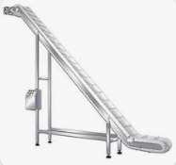
Output design
Research Page:
Identify the problem:
Clearly state an individual problem that you need to try to solve, or task that you are trying to make your robot accomplish. (i.e. do you need to lift something, grab something, push something, turn better, etc.)
We must lift the ball to a height that allows us to score. This height must also be changeable.
2. Find real-world examples:
Paste in pictures, video links, or screenshots of real-world examples that look like they could do the thing you are trying to do.
An inclined conveyor will be the first part. It will allow the block to be moved where it can be sorted into different goals.
On page 34-35 we designed an intake mechanism. We could use this same mechanism to sort the blocks into different goals.
Also see pg. 34-35
3. Brainstorm:
How could this example be scaled down or changed to solve your problem? What could you do to make it work?
We could build an inclined conveyor that leads to a mechanism like our intake. The conveyor will lead to a height where another mechanism can be used to score different goals. The output will be able to spin multiple ways to allow the block to go into different goals.
John
9-3-25
47

Slide 49


Upper scoring system 1
Plan and Design Page:
John Hopkins
9-3-25
48

Slide 50
Scrum meeting. Week of: MM/DD/YYYY
SCRUM Meetings
Week of 9/01/2025
Monday: Labor Day
Tuesday: No School
Wednesday: What has each team member done since the last meeting? What will each team member do today? What problems are holding the team back?
Thursday: What has each team member done since the last meeting? Designed the conveyor belt and output What will each team member do today? Begin building the conveyor on the robot What problems are holding the team back? None
Friday: What has each team member done since the last meeting? Got a small part of the conveyor belt built and started working on autonomous ideas What will each team member do today? Continue working on the conveyor What problems are holding the team back? none

Slide 51
“Push Back” Starting Field with Frozen Game Objects
Autonomous Plan 1
Deposit blocks to goal
Start pos
Pick up as many blocks here as possible
Kirby Larson
9/3/25

Slide 52



“Push Back” Starting Field with Frozen Game Objects
Autonomous Plan 2
Start pos
Clear intake
Kirby Larson
9/4/25

Slide 53
SCRUM Meetings Week of 09/08/2025
Monday: What has each team member done since the last meeting? John and Ryder built Conveyor supports. What will each team member do today? Working on conveyor What problems are holding the team back? None
Tuesday: What has each team member done since the last meeting? Conveyor was attached What will each team member do today? Put the output on the robot What problems are holding the team back? None
Wednesday: What has each team member done since the last meeting? Built a mostly functional conveyor What will each team member do today? Add metal pieces to the frame to make the blocks go in the right places. What problems are holding the team back? None
Thursday: What has each team member done since the last meeting? Added parts to make the blocks move correctly. What will each team member do today? Read up on VEX Game Manual 2.0 changelogs and add more parts to make the blocks move correctly What problems are holding the team back? None
Friday: What has each team member done since the last meeting? Changed the design of the conveyor belt What will each team member do today? Changing the design of the conveyor belt... again What problems are holding the team back? The conveyor belt is slow

Slide 54
Scrum meeting. Week of: MM/DD/YYYY
SCRUM Meetings
Week of 09/15/2025
Monday: What has each team member done since the last meeting? Started working on new design of conveyor What will each team member do today? Work on the conveyor belt What problems are holding the team back? None
Tuesday: What has each team member done since the last meeting? Finished new conveyor belt What will each team member do today? Make supports for the conveyor belt What problems are holding the team back? Conveyor belt structure is sagging
Wednesday: What has each team member done since the last meeting? Added supports to the conveyor belt What will each team member do today? Adding guidance structures for the blocks at the top of the conveyor What problems are holding the team back? None
Thursday: What has each team member done since the last meeting? Added block guidance to the top of the conveyor What will each team member do today? Tighten the motors on the drivetrain and reinforce the aforementioned guidance What problems are holding the team back? None
Friday: What has each team member done since the last meeting? The entire bock guidance structure at the top of the conveyor has been completed. What will each team member do today? Testing the robot What problems are holding the team back? None

Slide 55
Scrum meeting. Week of: MM/DD/YYYY
SCRUM Meetings
Week of 09/22/2025
Monday: What has each team member done since the last meeting? Tested the output What will each team member do today? Adding wheels to help the blocks get from the intake to the conveyor What problems are holding the team back? None
Tuesday: What has each team member done since the last meeting? Adjusting top conveyer belt What will each team member do today? Adjust top conveyer belt What problems are holding the team back? none
Wednesday: What has each team member done since the last meeting? Swap intake motor and few structural fixes What will each team member do today? John will research how to take blocks out of loader, Ryder will fill out a testing worksheet What problems are holding the team back? none
Thursday: What has each team member done since the last meeting? Started work on the autonomous code and removed the brain What will each team member do today? Relocate the brain, organize wires, and code autonomous. What problems are holding the team back? None
Friday: What has each team member done since the last meeting? What will each team member do today? What problems are holding the team back?

Slide 56
Sprint Review
Sprint #:
Team:
2
Team Members Present:
37528B
Ryder Sandstrum
John Hopkins
Kirby Larson
Using complete sentences, give a summary of what your team accomplished this sprint. Also, identify which product backlog items you fully completed:
This sprint we have built the scoring system, which includes the intake, the conveyer belt, and the output.
2. Using complete sentences, tell me what your sprint goal was, did you meet that goal this sprint, and why you did or did not meet that goal:
Our sprint goal was "Research and design the rest of the scoring system, then test it, if extra time" and we met the goal by completing the scoring system.
3. What sprint backlog items do you need to move back to your product backlog? Put them in order of priority, highest priority should be at the top of the list.
Test the scoring system.
4. Demonstrate the product that you produced this sprint.
Page:
55

Slide 57
Sprint Retrospective
Sprint #:
Team:
Team Members Present:
2
Ryder Sandstrum
John Hopkins
Kirby Larson
37528B
During the Sprint Retrospective you will talk with your team and discuss the last sprint. You will need to reflect on how well your team is working together, be respectful but honest, and everyone should be allowed to express themselves. Then, answer the following questions:
What is working for our team, that we should CONTINUE doing (use complete sentences):
Designing and researching what we need to build before building, as well as extensive planning of our robot.
Also continue communicating with each other.
2. What is not working for our team, that we should STOP doing (use complete sentences):
N/A
3. What do we want to try doing as a team, that we should START doing (use complete sentences):
For Each thing we want to stop doing, we should have a thing to start that solves the issue!
We never started documenting progress with pictures, update notebook, so we should start doing that. (blame Kirby (aka me))
9-26-25
45
Date:
Page:

Slide 58
Sprint Plan (Sprint backlog and burndown)
Sprint #:
Team:
3
Team Members Present:
37528B
Kirby, John, and Ryder
Product Backlog (at the start of this sprint, what is your product backlog):
Design and build drivetrain and chassis
Design and build "Scoring system"
Frame
Intake
Conveyer belt
"Pink Notebook"
"Media Training"
Code
Driver Control code
Code motor groups etc
Skills
Autonomous match start.
Stress test the robot
Strategize skills and matches
Competition readiness check
Sprint Goal (write in full sentences what concise goal you have for the sprint):
Start coding the autonomous period for match and skills, and perfect the scoring system.
Sprint Backlog / Burndown (Break product backlog items into sprint backlog items)
Remember to INDENT sprint backlog items:
Task Date and name of who worked on:
Task | Date
Fix intake reliability issues | 10-21-25 John
Autonomous match start
Begin autonomous code | 9-29-25 Kirby
Code turning | 10-30-25 Kirby
Code block unloading | 10-30-25 Kirby
Code scoring | 10-30-25 Kirby
46
Page:

Slide 59
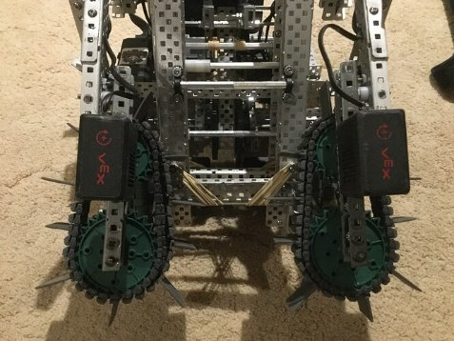
Block remover research
Research Page:
Identify the problem:
Clearly state an individual problem that you need to try to solve, or task that you are trying to make your robot accomplish. (i.e. do you need to lift something, grab something, push something, turn better, etc.)
We need an efficient method to clear the blocks out of the loaders. There is limited space to insert something into the loaders, and the blocks on top keep the lowest block from coming out.
2. Find real-world examples:
Paste in pictures, video links, or screenshots of real-world examples that look like they could do the thing you are trying to do.
Increasing Compression on Intakes and Expanding Everything - VEX V5 Technical Support - VEX Forum
3. Brainstorm:
How could this example be scaled down or changed to solve your problem? What could you do to make it work?
We could redesign the intake so that it could also pick up the blocks in the loaders, this is just an example, we will do something like this but use something other than flaps to move the balls.
John
9/29/25
59

Slide 60




Block loader block remover initial design
John
9/29/25
60

Slide 61
SCRUM Meetings
Week of 09/29/2025
Monday: What has each team member done since the last meeting? Kirby worked on coding for autonomous What will each team member do today? Work on autonomous code and redesigning intake What problems are holding the team back? Intake doesn’t work as well as expected
Tuesday: What has each team member done since the last meeting? Worked on the intake and worked on autonomous code What will each team member do today? Working on the intake What problems are holding the team back? None
Wednesday: What has each team member done since the last meeting? Team rebrand and sweatshirts designed. Ryder and John worked on the new intake. What will each team member do today? John is not here. Kirby will be working on autonomous code. What problems are holding the team back? None.
Thursday: What has each team member done since the last meeting? Kirby worked on making the robot turn 45 degrees. Ryder worked on getting a sensor and the intake. What will each team member do today? John will work on intake, kirby will work on making code templates, Ryder will help both What problems are holding the team back? None.
Friday: What has each team member done since the last meeting? John has worked on making the new intake still, and making sure the sizes are right. Kirby and Ryder have worked on the code What will each team member do today? Ryder and Kirby will work on code. John will cut pieces to size for the intake What problems are holding the team back? Another team keeps on using the cutting station so we are not able to use it.
61

Slide 62
SCRUM Meetings - Week of 10/06/2025
Monday: What has each team member done since the last meeting? John built half of our new intake. Kirby continued to work on autonomous code, specifically the turning precision. What will each team member do today? Kirby will continue to code, and John will continue to work on the new intake. What problems are holding the team back? None
Tuesday: What has each team member done since the last meeting? John finished the new intake and Kirby working on autonomous code. What will each team member do today? Ryder and John are attaching the new intake What problems are holding the team back? None
Wednesday: What has each team member done since the last meeting? Team tested the new intake and Kirby modified code to make it work with the new intake. What will each team member do today? John will continue to work on the new intake and Kirby will continue to work on the autonomous code What problems are holding the team back? None
Thursday: What has each team member done since the last meeting? John worked on the new intake and Kirby worked on autonomous code. What will each team member do today? Kirby will continue wot work on autonomous code and John will continue to work on the new intake. What problems are holding the team back? None
Friday: Field trip day – team absent
62

Slide 63
Scrum meeting. Week of: MM/DD/YYYY
SCRUM Meetings - Week of 10/20/2025
Monday: What has each team member done since the last meeting? John took the robot home over fall break and attached the new intake to the robot. What will each team member do today? John and Ryder will finalize parts on the robot. What problems are holding the team back? None
Tuesday: What has each team member done since the last meeting? What will each team member do today? John and Ryder are adjusting the intake to work with the loaders on the field. What problems are holding the team back? None
Wednesday: What has each team member done since the last meeting? John and Ryder tested new wheels for the intake What will each team member do today? John and Ryder are fixing minor integrity issues with the robot. Kirby will work on autonomous. What problems are holding the team back? None
Thursday: What has each team member done since the last meeting? John and Ryder put bigger wheels on the intake and added structural integrity What will each team member do today? John and Ryder are fixing the intake. Kirby is working on autonomous. What problems are holding the team back? Intake is having some issues with elasticity
Friday: What has each team member done since the last meeting? Kirby and Ryder worked on autonomous. What will each team member do today? Kirby and Ryder are working on autonomous What problems are holding the team back? None

Slide 64
Scrum meeting. Week of: MM/DD/YYYY
SCRUM Meetings - Week of 10/27/2025
Monday: What has each team member done since the last meeting? Kirby and Ryder worked on autonomous and added a bumper switch What will each team member do today? Kirby is going to code the bumper switch What problems are holding the team back? None
Tuesday: What has each team member done since the last meeting? Kirby coded the bumper switch and tested it. What will each team member do today? Ryder and Kirby replaced the bumper switch with a sonar sensor What problems are holding the team back? Bumper switch does not trigger sometimes.
Wednesday: What has each team member done since the last meeting? Ryder Installed the sonar sensor and Kirby partially coded it. What will each team member do today? Kirby will finish the sonar sensor code and finalize match autonomous. What problems are holding the team back? None
Thursday: What has each team member done since the last meeting? Ryder practiced driving and watched match videos. What will each team member do today? Kirby will finalize autonomous What problems are holding the team back? None
Friday: What has each team member done since the last meeting? What will each team member do today? What problems are holding the team back?

Slide 65
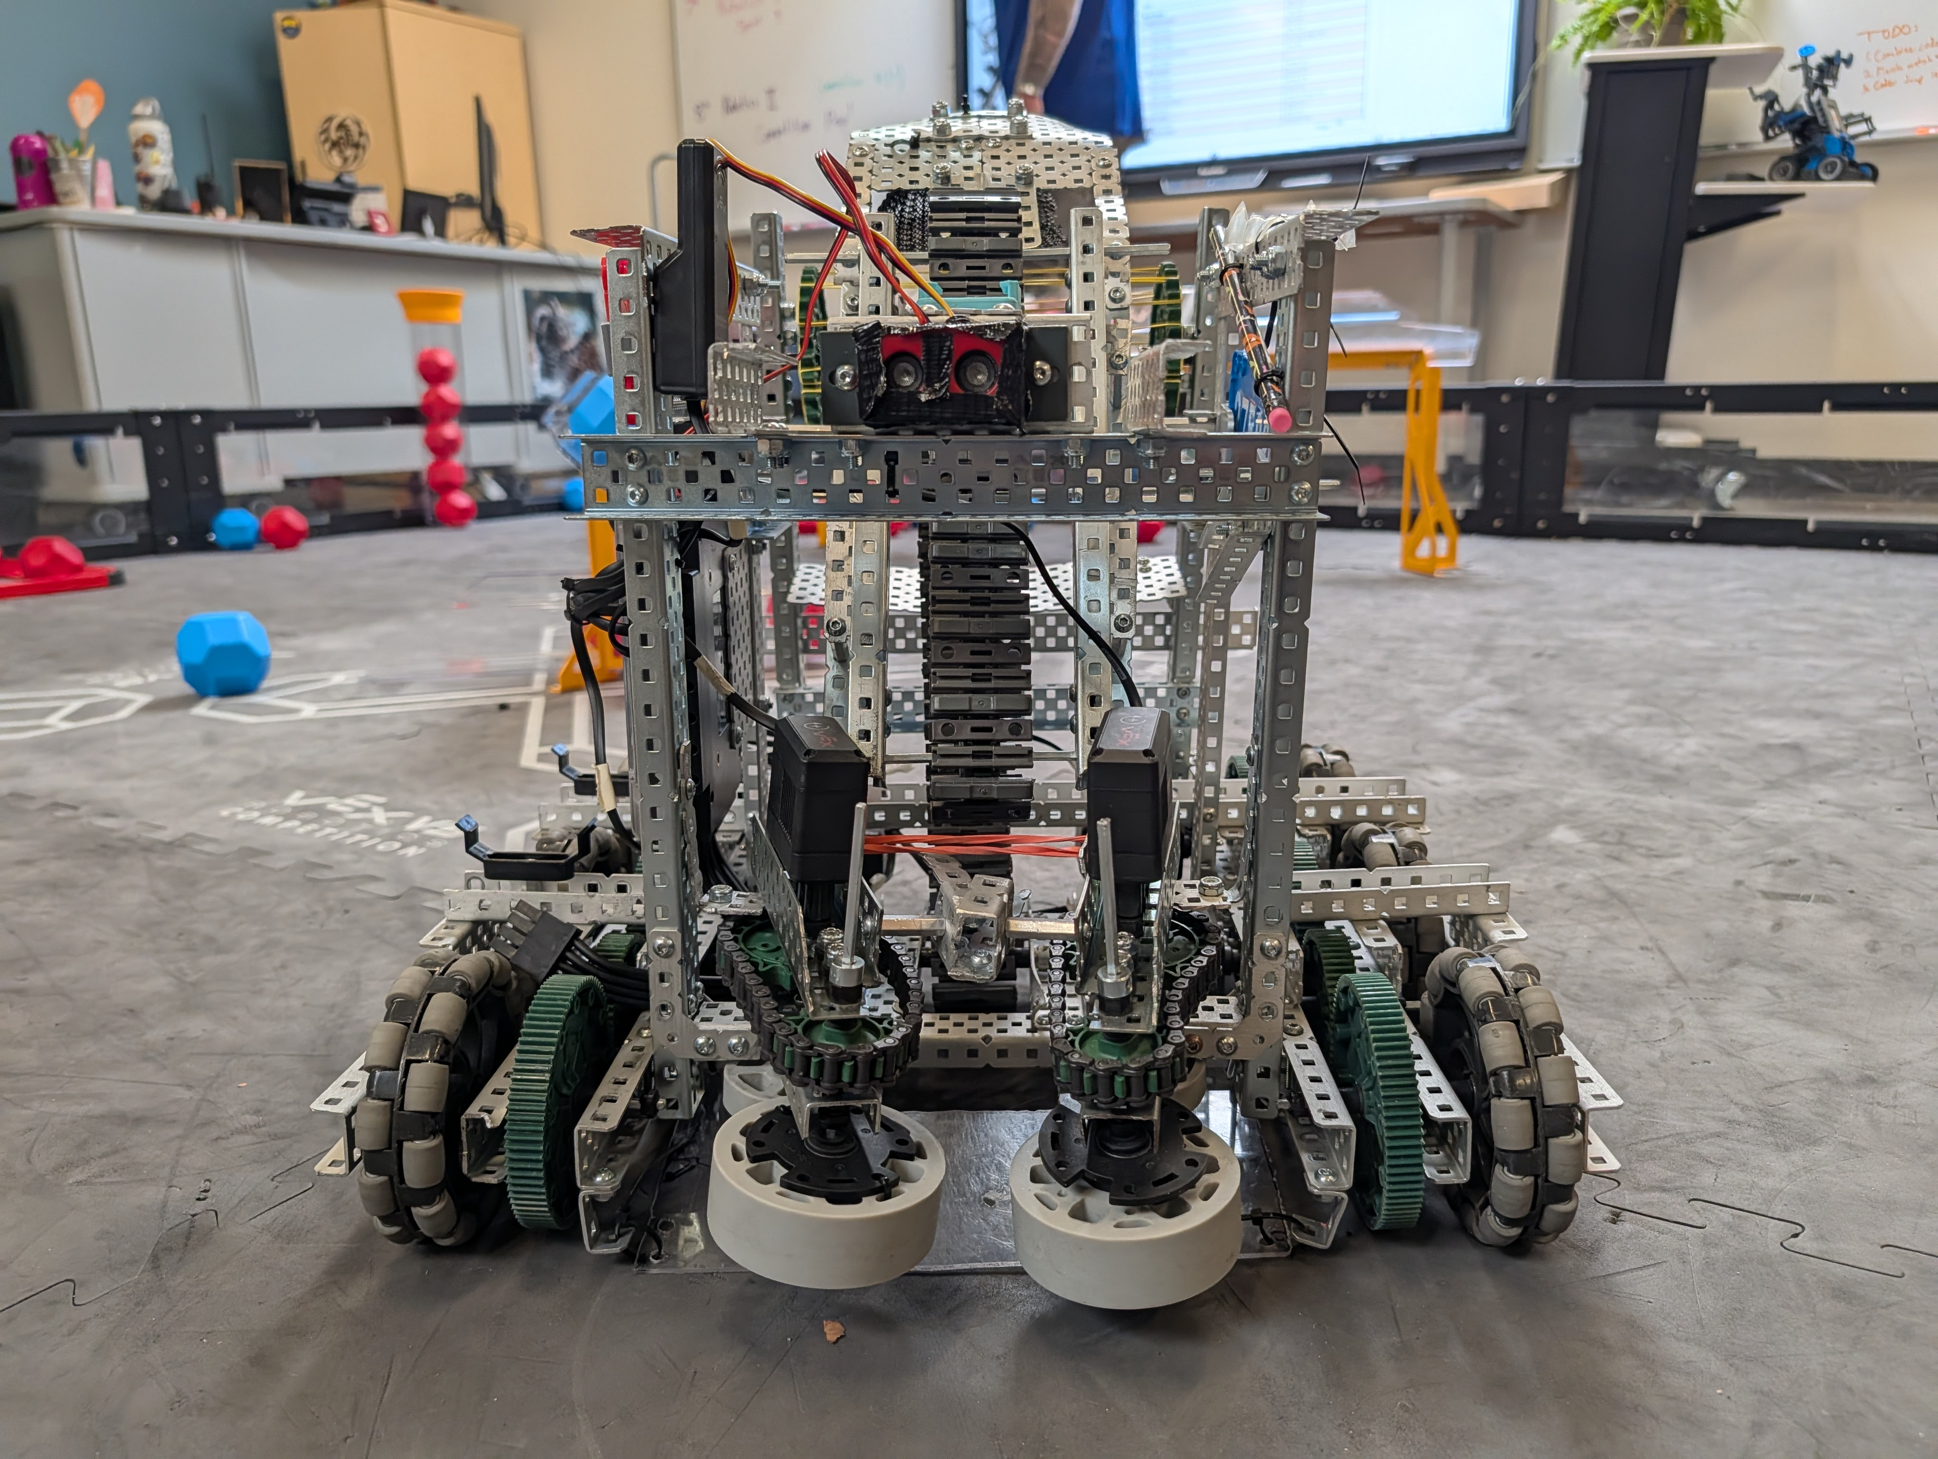
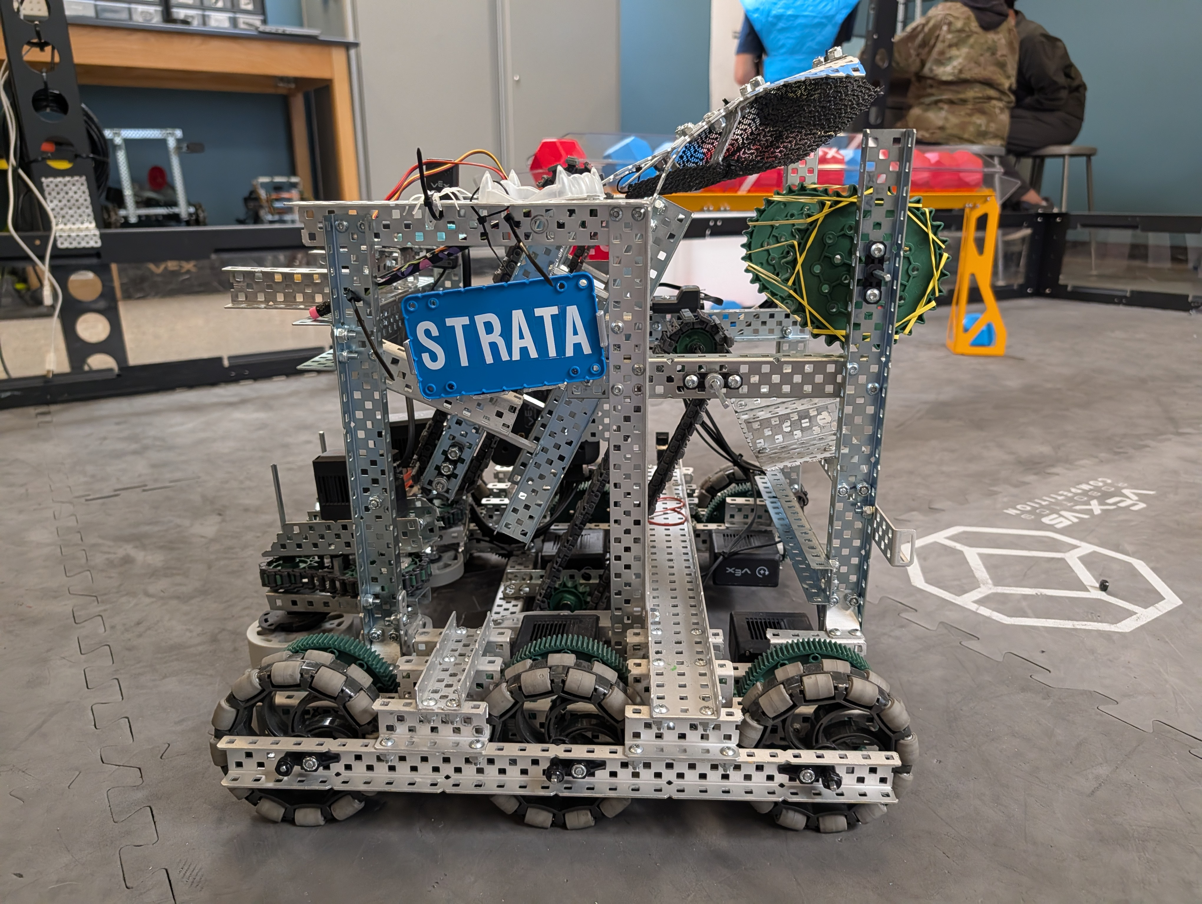
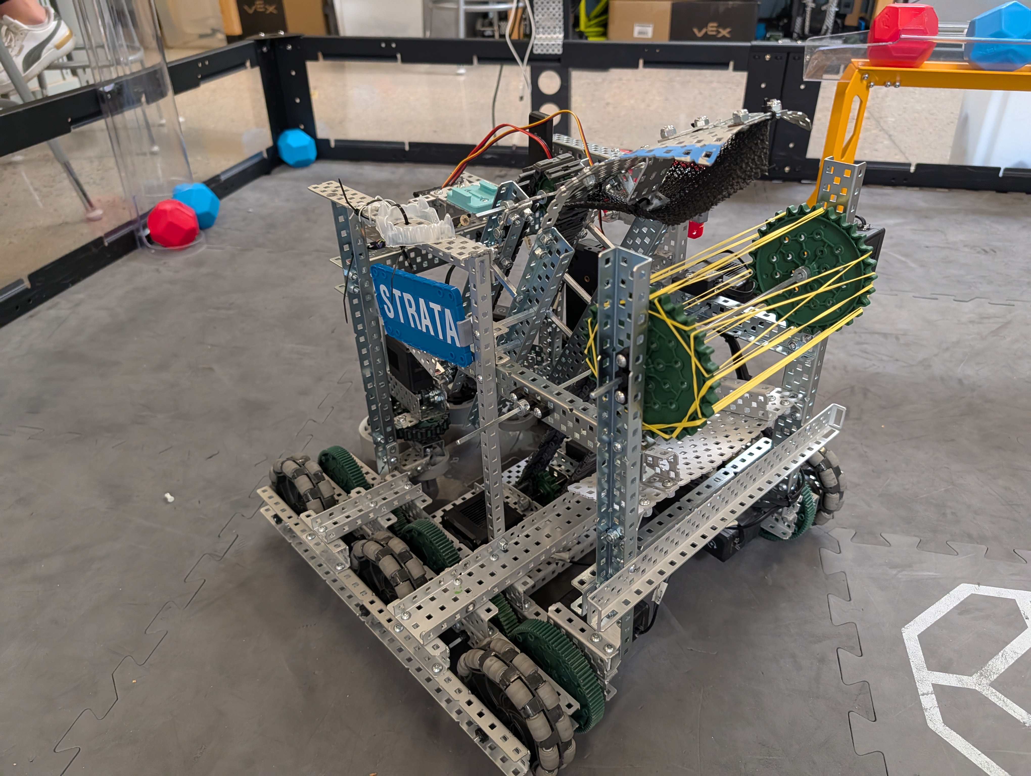
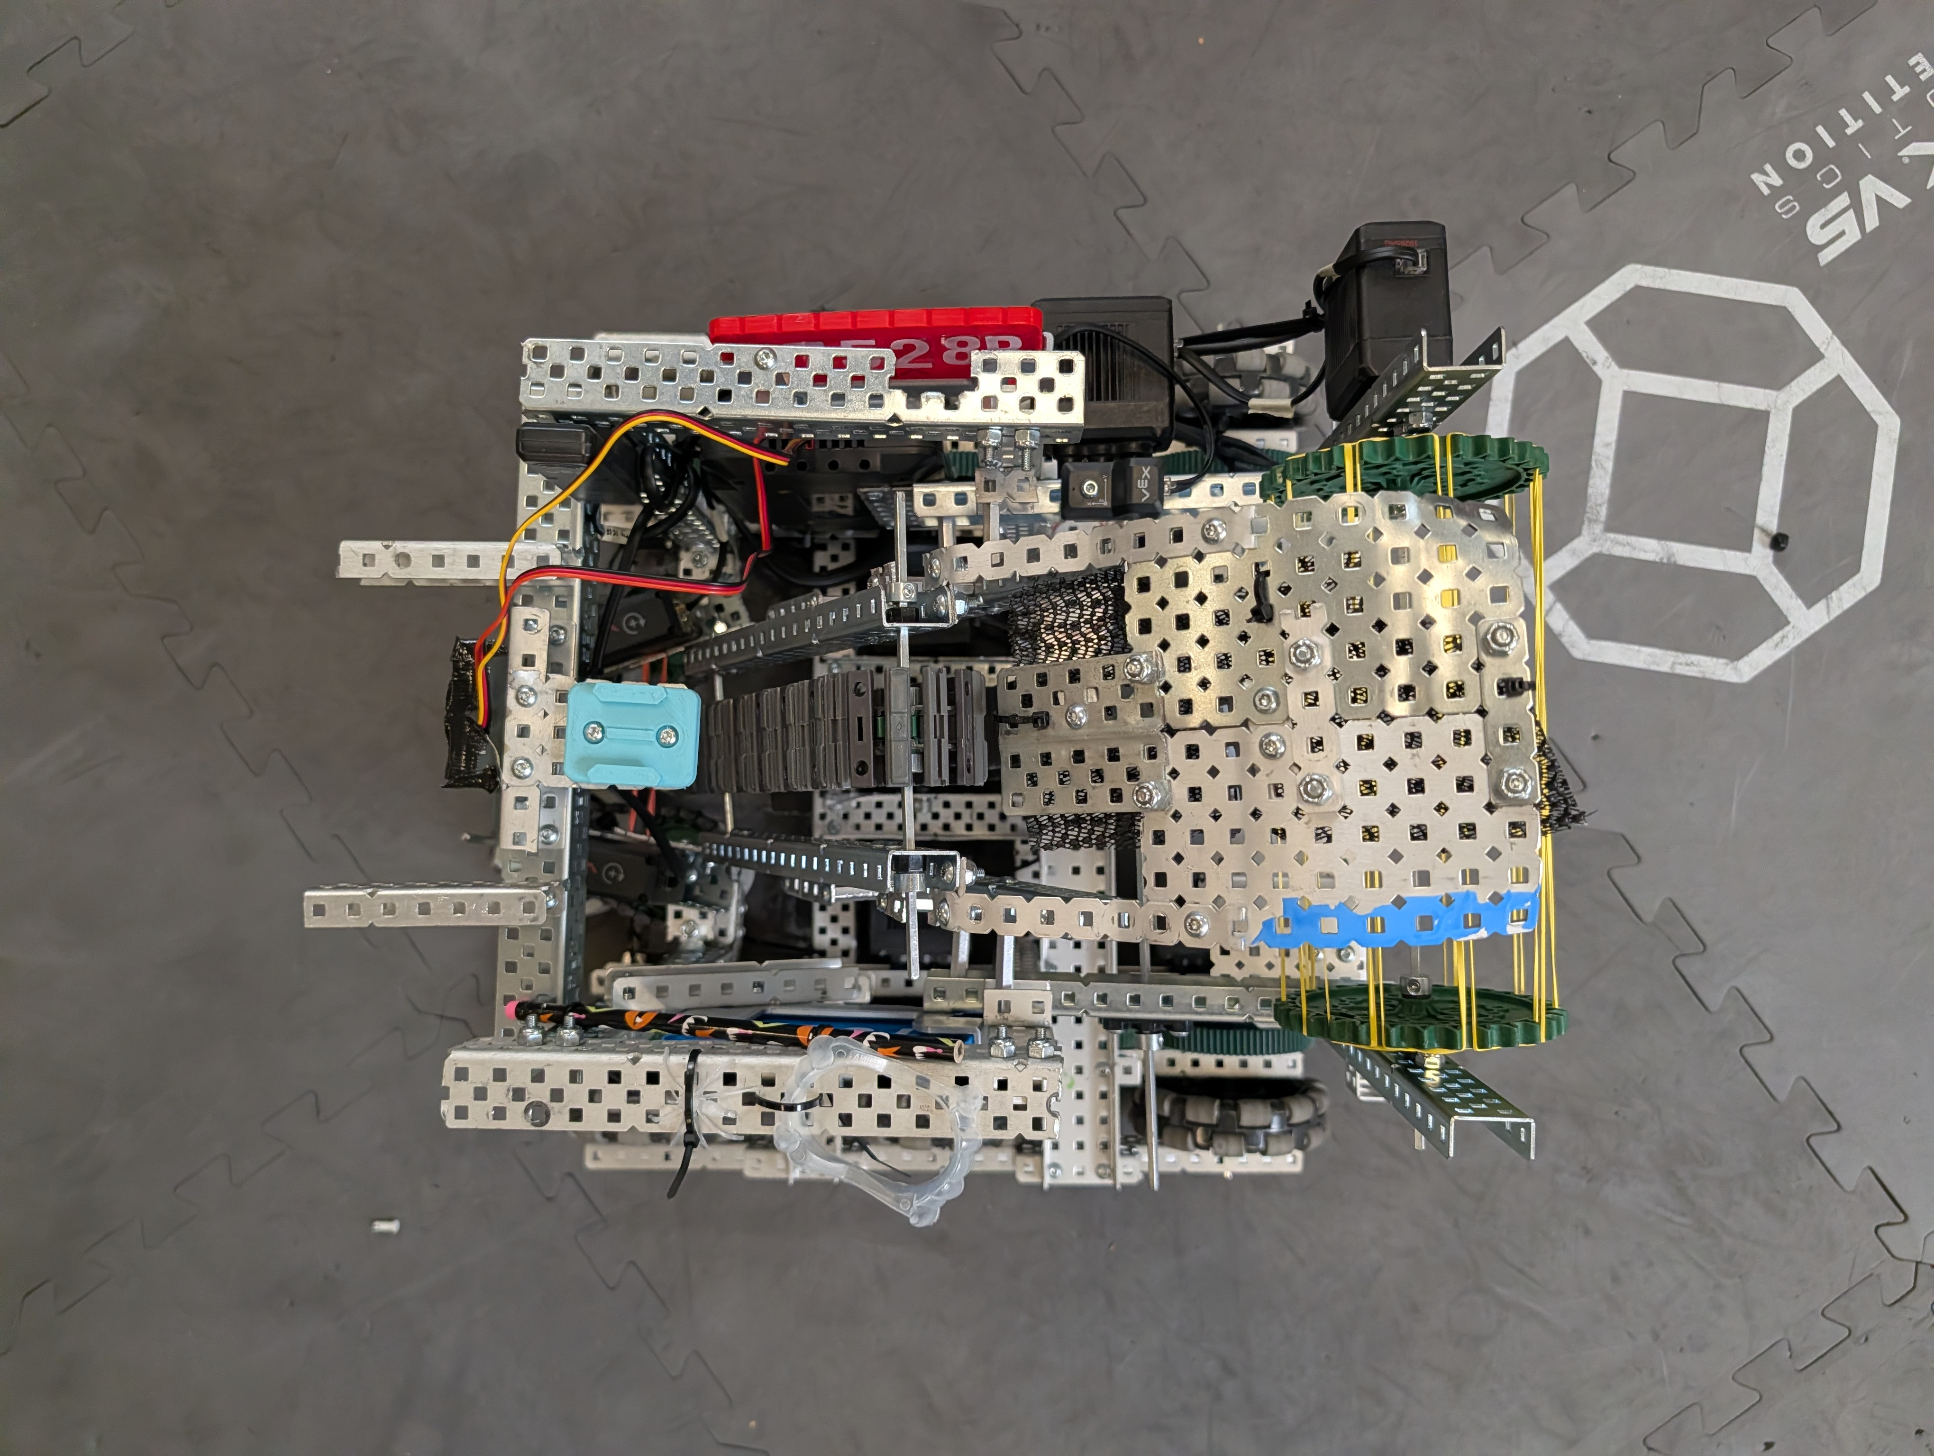
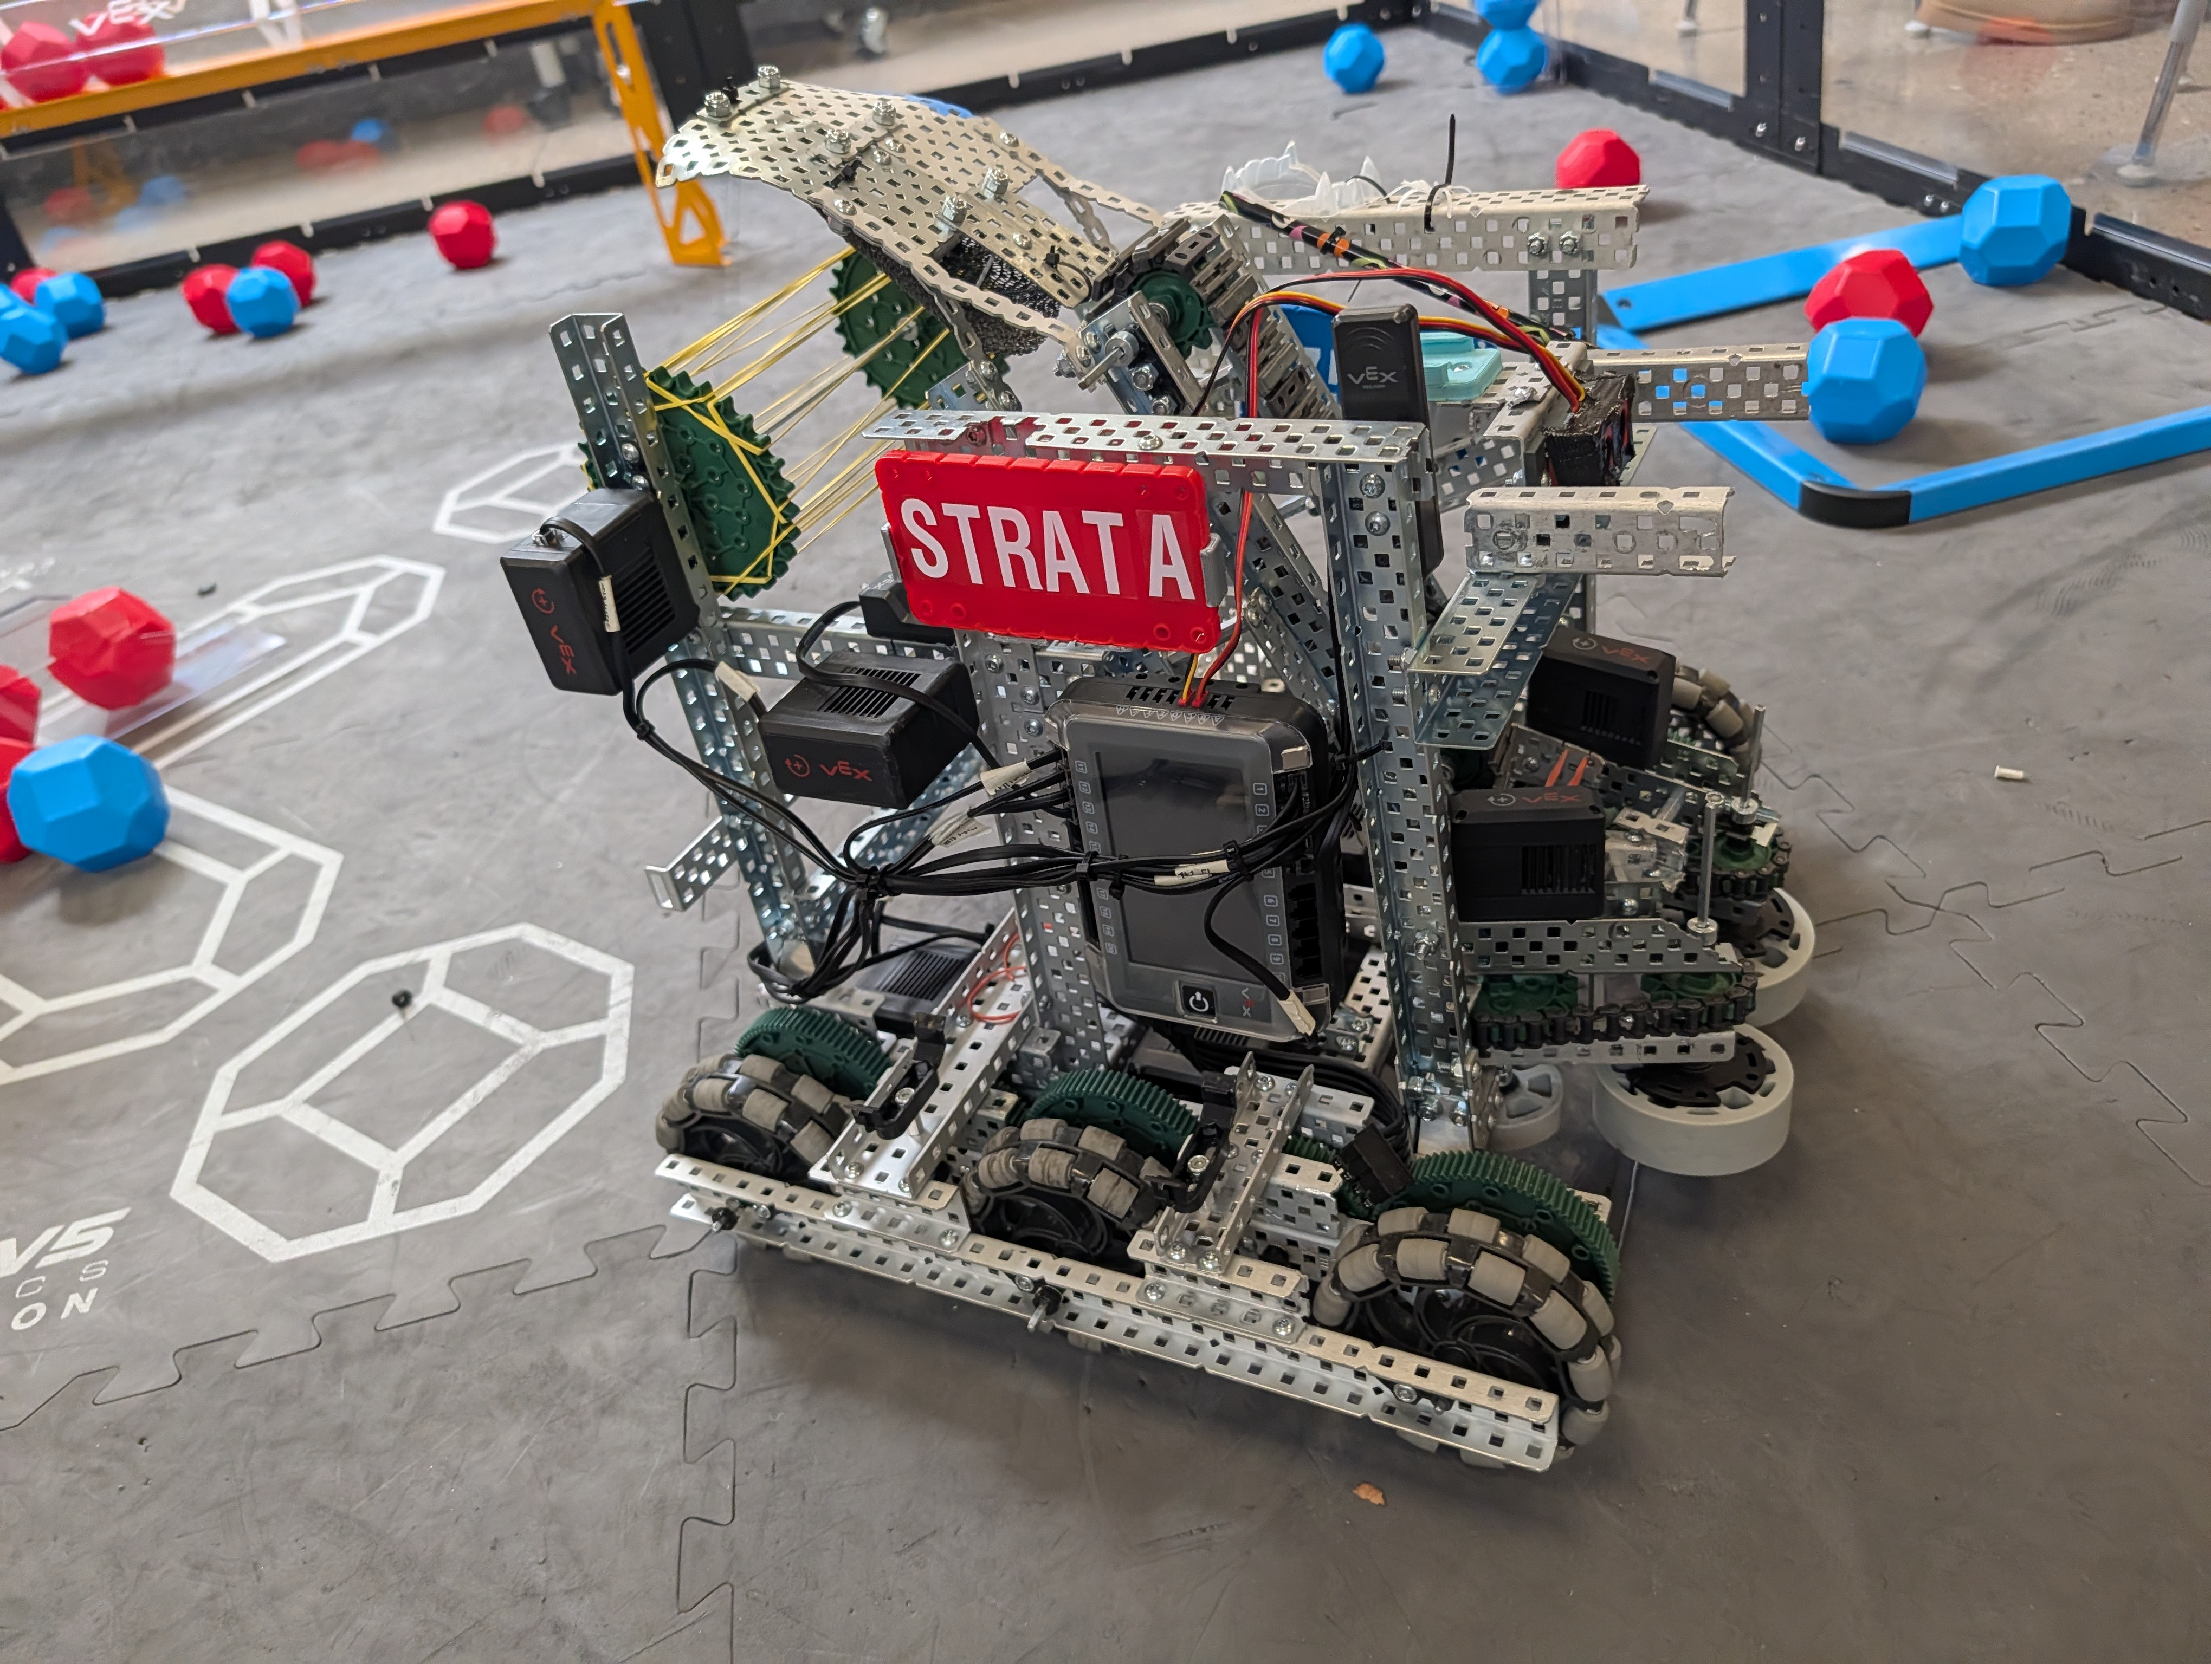
Final Robot Images
10/31/25

Slide 66
Reflection
Competition reflection
Robot changes:
Change intake hinges
Add goal unloader
Better license plate removal system
Triangle
More reliable intake
Swap intake codes
Potentially redesign conveyer belt and top scorer
Pneumatics grabber
Code changes:
Kirby needs more time to code.
Vexcode online
Fix other side for code
Allow skills code to unload the other loader
Driver control changes:
More driver practice time
Strategize skills
Work on parking
Additional notes:
11-3-25

Slide 67
Sprint Retrospective
Sprint #:
Team:
Team Members Present:
3
Ryder Sandstrum
John Hopkins
Kirby Larson
37528B
During the Sprint Retrospective you will talk with your team and discuss the last sprint. You will need to reflect on how well your team is working together, be respectful but honest, and everyone should be allowed to express themselves. Then, answer the following questions:
What is working for our team, that we should CONTINUE doing (use complete sentences):
Leaving each person to their own jobs. We have all acknowledged that Kirby the best coder, John is the best builder, and Ryder is the best driver.
We preformed pretty well at the CECFC comp on November 1st. We communicated well
2. What is not working for our team, that we should STOP doing (use complete sentences):
N/A
Ryder should stop giving Mr lyon bad ideas
3. What do we want to try doing as a team, that we should START doing (use complete sentences):
For Each thing we want to stop doing, we should have a thing to start that solves the issue!
Synergy with other teams, and CECW teams. We should start designing and building parts separately from the robot, giving more time to the coder and driver. This can be done from carefully designing and measuring parts to make sure the part works before it is added to the robot.
11-3-25
64
Date:
Page:

Slide 68
Sprint Review
Sprint #:
Team:
3
Team Members Present:
37528B
Ryder Sandstrum
John Hopkins
Kirby Larson
Using complete sentences, give a summary of what your team accomplished this sprint. Also, identify which product backlog items you fully completed:
The last sprint we spent getting ready for the competition and final touches on our robot. The intake worked perfectly (when it wasn’t broken) and most of the rest of the robot was the same.
2. Using complete sentences, tell me what your sprint goal was, did you meet that goal this sprint, and why you did or did not meet that goal:
Start coding the autonomous period for match and skills, and perfect the scoring system.
The code would have worked but was very inconsistent, which we believe we could fix by adding a catch onto our robot to line the intake up into the loader. But the actual scoring system worked quite great, other than often being unreliable.
We partially met the goal.
3. What sprint backlog items do you need to move back to your product backlog? Put them in order of priority, highest priority should be at the top of the list.
Currently, none.
4. Demonstrate the product that you produced this sprint.
Page:
44

Slide 69
Sprint Plan (Sprint backlog and burndown)
Sprint #:
Team:
4
Team Members Present:
37528B
Kirby, John, and Ryder
Product Backlog (at the start of this sprint, what is your product backlog):
Design and build drivetrain and chasis
Design and build "Scoring system"
Mechinism to take blocks out of loader
"Pink Notebook"
"Media Training"
Fix robot and redesign small parts
Pneumatics (Unloader, Grabber)
Code
Driver Control code
Code motor groups etc
Skills
Autonomous match
Stress test the robot (2)
Strategize skills and matches (2)
Competition readiness check (2)
Sprint Goal (write in full sentences what concise goal you have for the sprint):
We will start coding the autonomous period for match and skills, and perfect the scoring system.
Sprint Backlog / Burndown (Break product backlog items into sprint backlog items)
Remember to INDENT sprint backlog items:
Task Date and name of who worked on:
Task | Date of completion
Fix intake reliability issues | 11-19-25 John
Fix goal alignment issues | 11-6-25 Ryder
Fix programming issues
46
Page:

Slide 70
Scrum meeting. Week of: MM/DD/YYYY
SCRUM Meetings - Week of 11/03/2025
Monday: What has each team member done since the last meeting? Team competed in Fort Collins What will each team member do today? Team will discuss comp review What problems are holding the team back? None
Tuesday: What has each team member done since the last meeting? Team discussed competition review What will each team member do today? John and Ryder are designing fixes to the problems experienced at the comp What problems are holding the team back? None
Wednesday: What has each team member done since the last meeting? Designed and planned adding a triangle to the back of the robot to aid in aligning the robot with upper goals What will each team member do today? Built the aforementioned triangle What problems are holding the team back? None
Thursday: What has each team member done since the last meeting? Put the alignment triangle on the robot What will each team member do today? Planning lever for pushing blocks in the goal What problems are holding the team back? None
Friday: No school

Slide 71


Intake arm newest design
John
11/3/25 ?
60

Slide 72

Descorer concept (unused)
John
11/6/25
60

Slide 73
Scrum meeting. Week of: MM/DD/YYYY
SCRUM Meetings - Week of 11/10/2025
Monday: What has each team member done since the last meeting? Worked on pneumatics for block push lever What will each team member do today? Kirby will work on code for the pneumatics system. What problems are holding the team back? None
Tuesday: What has each team member done since the last meeting? Coded Pnumatics What will each team member do today? Mount Pnumatics What problems are holding the team back? None
Wednesday: What has each team member done since the last meeting? Ryder mounted and tested pneumatics system on the robot. John worked on fixing the intake. What will each team member do today? John is working on fixing the intake. What problems are holding the team back? None
Thursday: What has each team member done since the last meeting? John worked on mounting the intake with a new method. What will each team member do today? John will continue working on the intake, and Kirby will hopefully have time to work on auton What problems are holding the team back? Intake is not in a state good enough to work on code
Friday: What has each team member done since the last meeting? John worked on the intake. Kirby did not have time to code. What will each team member do today? John will continue to work on the intake. What problems are holding the team back? Intake is not in a state good enough to work on code

Slide 74
Scrum meeting. Week of: MM/DD/YYYY
SCRUM Meetings - Week of 11/17/2025
Monday: What has each team member done since the last meeting? John worked on the intake. What will each team member do today? John will be working on the new intake What problems are holding the team back? None
Tuesday: What has each team member done since the last meeting? John worked on the intake. What will each team member do today? John and Ryder will work on the intake. What problems are holding the team back? None
Wednesday: What has each team member done since the last meeting? John and Ryder worked on the intake What will each team member do today? John will work on the intake What problems are holding the team back? None
Thursday: What has each team member done since the last meeting? John finished working on the intake and started working on the descorer. What will each team member do today? John and Ryder will work on the descorer. What problems are holding the team back? None
Friday: What has each team member done since the last meeting? John worked on the descorer and Kirby worked on auton code. What will each team member do today? Kirby will work on autonomous code, Ryder will practice driving, and John will continue working on the descorer What problems are holding the team back? None

Slide 75
Scrum meeting. Week of: MM/DD/YYYY
SCRUM Meetings - Week of 12/01/2025
Monday: What has each team member done since the last meeting? John worked on the descorer What will each team member do today? John will work on the descorer and Kirby will hopefully have enough time to work on auton What problems are holding the team back? None
Tuesday: What has each team member done since the last meeting? John got a working descorer on the robot and Kirby worked on auton code What will each team member do today? John is adding wheel bumpers on the robot per Ryder's request. What problems are holding the team back? None
Wednesday: What has each team member done since the last meeting? John worked on improving the descorer and put bumpers on the wheels. What will each team member do today? John will continue to work on the descorer and attach the rest of the bumpers What problems are holding the team back? None
Thursday: What has each team member done since the last meeting? John improved the descorer and attached another bumper, sprint review, retrospective, and plan were worked on, Kirby worked on auton and got it almost working What will each team member do today? John will work on a hot-swap license plate mount What problems are holding the team back? None
Friday: What has each team member done since the last meeting? John made one hot-swap license plate mount and Ryder tightened the drivetrain motors What will each team member do today? John will make a second hot-swap license plate mount Sprint review, retrospective, and plan What problems are holding the team back? None

Slide 76
Sprint Review
Sprint #:
Team:
4
Team Members Present:
37528B
John, Kirby, Ryder
Using complete sentences, give a summary of what your team accomplished this sprint. Also, identify which product backlog items you fully completed:
This sprint we completed: (Fix and redesign robot) fix broken parts from competition, redesign grabber, attach grabber, add triangle, fix small design issues,(Pneumatics) Figure out how to make a piston work, build block descorer, attach piston and descorer, code piston and descorer. Kirby also had to restart his autonomous code, and he completed some of basic driving and turning.
2. Using complete sentences, tell me what your sprint goal was, did you meet that goal this sprint, and why you did or did not meet that goal:
Our sprint goal was to fix and complete the autonomous codes, and to perfect the scoring system. We did not complete the coding because it took too long to build and fix the robot, and the original code for the robot didn't end up working as we wanted to; however, we did manage to fix most of the flaws with scoring by changing the hinges so that the intake has less movement, is more reliable, and doesn't break as often. Additionally, we added a triangle for better alignment and added a descorer to remove opponent blocks.
3. What sprint backlog items do you need to move back to your product backlog? Put them in order of priority, highest priority should be at the top of the list.
We need to move back autonomous scoring, other side autonomous, and skills autonomous to the product backlog. Autonomous scoring is our highest priority and autonomous skills as the second highest priority.
4. Demonstrate the product that you produced this sprint.
Dec 4, 2025
Page:
76

Slide 77
Sprint Retrospective
Sprint #:
Team:
Team Members Present:
4
John, Ryder, Kirby
37528B
During the Sprint Retrospective you will talk with your team and discuss the last sprint. You will need to reflect on how well your team is working together, be respectful but honest, and everyone should be allowed to express themselves. Then, answer the following questions:
What is working for our team, that we should CONTINUE doing (use complete sentences):
Again, respecting team roles is incredibly helpful for our robot. As well as following a structure for our future. We can also keep giving advice to other teams to improve their robots
2. What is not working for our team, that we should STOP doing (use complete sentences):
Kirby and Ryder are often getting distracted but right now Kirby is very important for our team because the upcoming sprint is meant to make our code again. But we also need to manage having to optimize time with our robot so can split testing, code, etc.
3. What do we want to try doing as a team, that we should START doing (use complete sentences):
For Each thing we want to stop doing, we should have a thing to start that solves the issue!
We are going to make the members of 37528A stay away from our table because they distract us.
12-5-2025
77
Date:
Page:

Slide 78
Sprint Plan (Sprint backlog and burndown)
Sprint #:
Team:
5
Team Members Present:
37528B
Kirby, John, and Ryder
Product Backlog (at the start of this sprint, what is your product backlog):
Design and build drivetrain and chassis
Design and build "Scoring system"
Mechanism to take blocks out of loader
"Pink Notebook"
"Media Training"
Fix robot and redesign small parts
Pneumatics (Unloader, Grabber)
Code
Driver Control code
Code motor groups
Skills
Autonomous
Other side
Stress test the robot
Strategize skills and matches
Competition readiness check
Sprint Goal (write in full sentences what concise goal you have for the sprint):
This sprint we will work mainly on code: we will start by finishing and perfecting the current code then we will adjust it for skills and other side. We will also work on preparing for matches and competition
Sprint Backlog / Burndown (Break product backlog items into sprint backlog items)
Remember to INDENT sprint backlog items:
Task Date and name of who worked on:
Task | Date of completion
Code
Autonomous scoring
Finish Autonomous
Skills
Other Side
Stress Tests
Strategize
Competition Readiness
Media Training
Dec 4, 2025
46
Page:

Slide 79
Scrum meeting. Week of: MM/DD/YYYY
SCRUM Meetings - Week of 12/08/2025
Monday: What has each team member done since the last meeting? Scrum retrospection, review, plan. Whole team involved. What will each team member do today? Kirby code. Ryder driver skills, John work on making autonomous grab blocks from loaders What problems are holding the team back? Lack of time from comp, as well as the inability for the autonomous to grab loader blocks
Tuesday: What has each team member done since the last meeting? John and Ryder worked on output. Kirby worked on fixing errors in the code. What will each team member do today? Continued of yesterday What problems are holding the team back? Auton can take loader blocks, Camber on drivetrain is causing gears to rub against mat, causing unwanted friction.
Wednesday: What has each team member done since the last meeting? Ryder did driver practice and Kirby did autonomous code. John worked on fixing the intake to have a gap between the wheels and fit within size restrictions. What will each team member do today? John will work on fixing the intake What problems are holding the team back? Time to work on autonomous is blocked out by other teammates working on the robot
Thursday: What has each team member done since the last meeting? Kirby worked on autonomous code and John fixed the intake. What will each team member do today? Kirby will work on autonomous What problems are holding the team back? Inertial sensor is not working reliably
Friday: What has each team member done since the last meeting? Kirby worked on autonomous code What will each team member do today? Kirby will work on autonomous code What problems are holding the team back? None

Slide 80
Scrum meeting. Week of: MM/DD/YYYY
SCRUM Meetings - Week of 12/15/2025
Monday: What has each team member done since the last meeting? Kirby worked on auton What will each team member do today? Kirby is working on auton What problems are holding the team back? We are running out of time and our block system is unreliable
Tuesday: LAST DAY BEFORE WINTER BREAK What has each team member done since the last meeting? Kirby made an extreme amount of progress on auton, works significantly better What will each team member do today? Kirby will continue to make progress on auton, Jon will try to fix the block system. What problems are holding the team back? We are running out of time
Wednesday: No school
Thursday: No school
Friday: No school

Slide 81
Scrum meeting. Week of: MM/DD/YYYY
SCRUM Meetings - Week of 1/06/2025
Monday: No school
Tuesday: No school
Wednesday: What has each team member done since the last meeting? What will each team member do today? First day back to school: Kirby will work on auton What problems are holding the team back? None
Thursday: What has each team member done since the last meeting? Team reviewed where we are at, and Kirby and Ryder worked on right-side auton. What will each team member do today? Kirby will work on auton, Ryder will practice driver skills. What problems are holding the team back? Getting close to the deadline.
Friday: What has each team member done since the last meeting? Kirby worked on auton, Ryder practiced skills What will each team member do today? Kirby will work on auton. What problems are holding the team back? Movement is too inconsistent for auton

